Slide 1
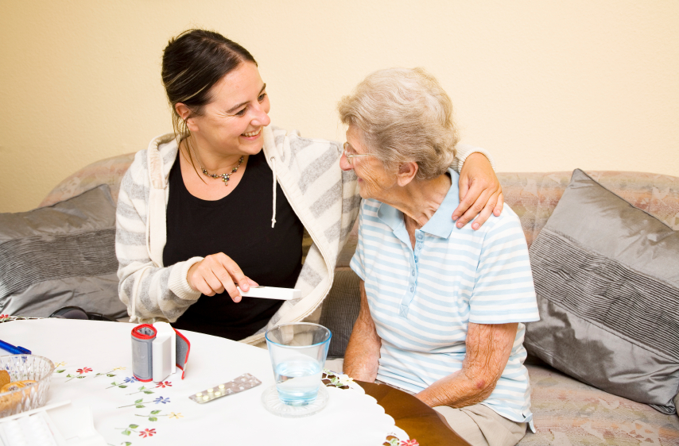
Action Learning Sets For Nursing Masters Students
Charlotte Maddison
Juliet Bostwick

Slide 2
Aim
Outline the background & purpose of action learning sets at OBU
Share some insights from evaluation and reflection on the process

Slide 3
What is action learning?
“….a way of learning from our actions, and from what happens to us, and around us, by taking the time to question, understand and reflect, to gain insights, and consider how to act in future”
Weinstein 2003
First introduced in 1980 by Reginald Revans as a management tool. He argued that the conventional instructional methods of teaching were ineffective. This being particulary relevant to health care.
Notes:
Revans proposed that learning is not merely the acquisition of knowledge through reading or listening to a teacher. He observed that his most successful colleagues were those who would discuss their ideas with others in an inquiring, problem focused way. By presenting a problem and allowing others to question us about that problem, Revans says that active learning and change will result. Therefore action learning involves reflection on our experiences and then help from others to make changes.

Slide 4
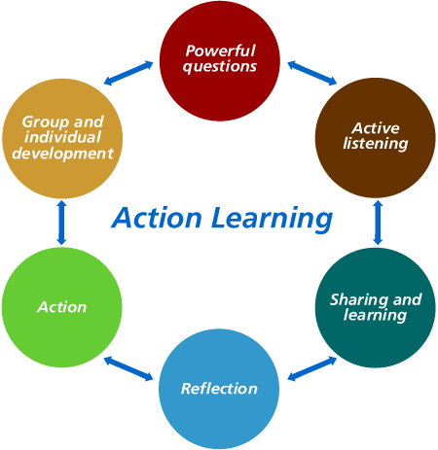
What is action learning ?
Notes:
Participants come to an action learning set with an intention to learn. Students are willing to share their ideas and knowledge. This will assist others in learning, however through constructive and powerful questioning participants can reach a new perspective and change their future practice as a result.

Slide 5
What is an action learning set?
Involves a group of people who work together on a problem or series of tasks
Usually 6 people with one facilitator. We will have 2 facilitators per group.
It is often work-based – whilst we do not hold our ALS in the practice setting the focus is on both academic and practice ‘problems’
Participants work in a constructive and effective way

Slide 6
Specific purpose of action learning to nursing masters students
Contribute to the achieving the programme learning outcomes.
Contribute to achieving the postgraduate attributes – in particular critical self-awareness and personal literacy & global citizenship
To fulfill the NMC requirements for inter-professional learning
To support & offer guidance in preparation of academic work
To develop a collegiate identity
Notes:
6
Programme Learning Aims:
The aim of all of your programmes is to graduate students who:
have developed transferable skills such as the ability to demonstrate self awareness and confidence in their own abilities and an emerging potential to supervise, manage and lead others.
demonstrate the skills to manage their own continuing professional development and work effectively with other professionals
have had opportunity to explore the theory and practice of nursing in both primary and acute care settings.
contribute significantly to high quality person centred care across the lifespan.
are competent in the knowledge, skills, behaviour and values required of students, commensurate with Progression Point 1 as laid out within the NMC Standards for pre-registration nursing education (2010).
Brookes Postgraduate Attributes
Academic literacy
Research literacy
Critical self awareness and personal literacy –Demonstrate commitment to continuous self-improvement. To include the ability to lead and organise self and others; take personal responsibility in unpredictable and complex situations; make sound and appropriate decisions; to inspire and interact with others in diverse environments.
Digital and information literacy
Global citizenship –Knowledge and skills showing cross-cultural awareness, and valuing human diversity. The ability to work effectively, and responsibly, in a global context. Knowledge of global perspectives on how disciplinary knowledge is represented and understood within our cultures; cross-cultural capability beginning with an awareness of our own culture and perspectives and the development of the confidence to question one’s own values and those of others responsibly and ethically; and responsible citizenship, actively engaging with issues of equity and social justice, sustainability and the reduction of prejudice, stereotyping and discrimination.

Slide 7
What we explored –via papers and/or scenarios from practice
Beliefs & values: The impact of own beliefs & values on the provision of person centred care
Essential care of other groups
Breast feeding
Policy & legislation & the impact upon health
Legal & ethical issues – restraint
Self-harm
Pain assessment & management in the neonate – facilitated cross discipline discussion about the subject in each field of nursing
Leadership
Notes:
7

Slide 8
Some notable comments
Improves communication - provides a safe place to discuss; it is a good place to vent – discuss practice issues. Has improved communication across professional boundaries e.g. mental health, child & adult nursing, but we would have liked to see midwives. Enjoyed sharing experience of practice. Found this helped with counteracting the stress of being a student nurse.
Teaches value and respect -It provides a safe learning environment; respect for each other is shown and everyone has a chance to voice their opinions. Helps us to respect other job roles. It enables us to maintain our values & respect despite politics etc
Promotes active listening -Respect; chance to speak about experience and voice opinions/understand the opinions of others. Helps us to look after each other’s’ mental health. – builds resilience.
Notes:
8

Slide 9
Some notable comments
Offers support Respect; chance to speak about experience and voice opinions/understand the opinions of others. YES – excellent! For example inter-disciplinary support and networking. Learnt about other disciplines, things I may not have otherwise known. It has been good to be an MSc student without being judged.
Empowering Encouraged to take leadership role and speak up about practice. Increased confidence.
Notes:
9

Slide 10
Some personal reflections of the facilitators
Offering a structure at the start is important – helps to establish purpose with students, and assists in the transition from graduate to post-graduate student.
The ability to be flexible and responsive is an essential skill for facilitators – we found the changing needs and experience within the student’s programmes often impacted on the student’s engagement with the ALS.
Our own beliefs & values have been challenged
Being able to explore concepts and problems with the mixed field has been enlightening, empowering and has strengthened our own knowledge base
Addressing topics such as pain, self-harm & breastfeeding across the fields leads to a richer understanding & promotes a sense of responsibility to all people
Students want to be co-creators in their learning
The potential to build resilience was an unexpected but welcome outcome.
MSc students feel ‘judged’ in practice – this needs further exploration.
Notes:
10

