Slide 1
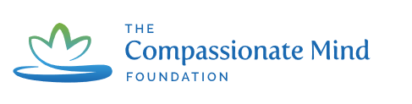
Implementation of compassion focused clinical supervision to improve resilience, self-efficacy and compassion towards self and others amongst student nurses.
Grace Cook
Notes:
Introduce selves.

Slide 2
Contents
Background
What is Compassion Focused Clinical Supervision?
Case study
Grounding Exercise
Scenario
What do students think?

Slide 3
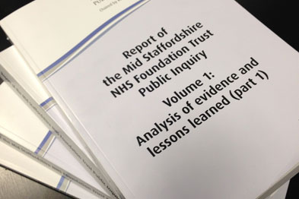
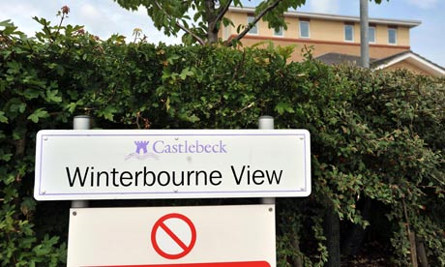
“Too Posh To Wash”
“Too Clever to Care”
Notes:
Introduce the reports and lack of compassion in nursing.
Increase in academia – led to none caring nurses.
But is it more complicated than that?

Slide 4
Is it more complicated than that?
Higher levels of education can have a more positive affect (Aiken et al., 2014).
Compassion is time intensive. Staff are unable to be compassionate in a state of stress, anxiety or against time pressures (Crawford et al., 2013).
Notes:
Large European cross-sectional study found that for every 10% increase in degree level nurses, mortality rate decreased by 7%. Suggests that increase in knowledge is a positive thing. However still concerns from service users that nurses have lost the ‘softer side.
More complex social process- compassion is time intensive. Also has affect on mortality. Increase in nurses workload by 1 patient increased likelihood of mortality by 7%. Higher nurse- patient rations in other countries in Europe than England.
We can explain this using compassion theory.

Slide 5
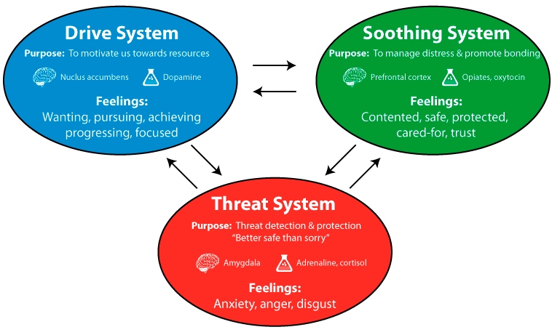
Gilbert, 2010
Notes:
what of 3 different emotional regulation systems.
Explain drive and soothing first.
Threat: This links to compassion in that Gilbert argues that compassion begins by recognising our mental mechanisms are survival orientated and are designed to protect us from harm.

Slide 6
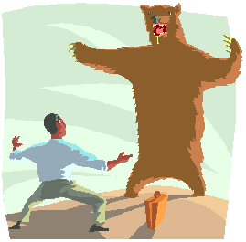
Heavy workloads
Staff shortages
Shift working
Missing breaks
Paperwork targets/Audits
_{Fight}
_{Flight}
(RCN, 2013, Brown et al., 2014, Crawford et al., 2013).
Notes:
Talk about fight or flight.
Threats in healthcare service – low staffing and lack of resources, (these are viewed by healthcare professionals
Gilbert argues that the threat in the healthcare culture can lead to constant defensive reaction that results in a lack of compassion being expressed. (these are what have been identified in a number of surveys.)
As previously said pre-reg nurses initially feel excited about their role however these pressures can lead to individuals working in a negative environment. environment with no role models. This in turn can cause student nurses and newly qualified nurses feeling vulnerable, overwhelmed and frustrated as they want to be compassionate and remain compassionate whilst accepting the realisation that they may need to adapt in order to survive in practice. Working in this environment is a difficult thing for many students/newly qualified nurses.

Slide 7
Compassion Focused Clinical Supervision
“uses different facets throughout a process of alleviation and prevention whereby the practitioner is encouraged to pay attention and to apply reasoning to subsequent behaviours and responses towards each other. In doing this the practitioner may then develop competencies that enable them to regulate their response to threat and monitor their own wellbeing whilst also paying attention to the complex social context in which these competencies need to be applied.”
Notes:
It uses the different facets of a compassionate mind.

Slide 8
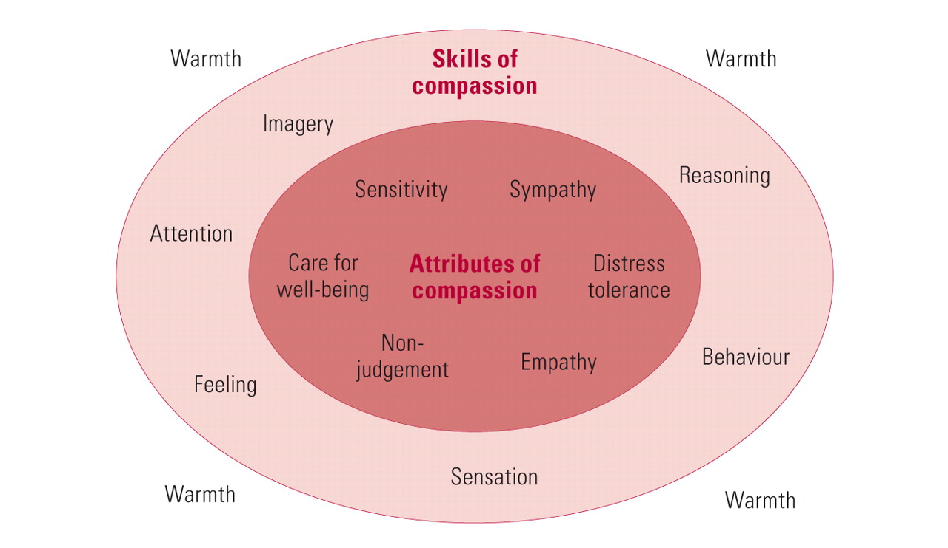
Notice and Explore
Notes:
Brief explanation of the attributes and skills.
Attention – paying attention to what is the critical voice – brief explanation of the critical voice and explain how that can help with the attributes of compassion.
Mantra – notice and explore.

Slide 9
Grounding Exercise
Meet Susanna…
http://www.patientvoices.org.uk/flv/0365pv384.htm
Notes:
Grounding – not about relaxing aim is to ensure individuals are in the moment and there minds are not elsewhere. It gives individuals a breathing space before the start of the session which can aide better reflection.
Just a taster – number of different grounding exercises you can try.
Susanna is a newly qualified nurse who has already had her values going into nursing questioned- play from start to 1.51.
Role play!

Slide 10
Gilbert, 2010
Notes:
what of 3 different emotional regulation systems.
Explain drive and soothing first.
Threat: This links to compassion in that Gilbert argues that compassion begins by recognising our mental mechanisms are survival orientated and are designed to protect us from harm.

Slide 11
What Do Students Think?
Notes:
Research question

Slide 12
“a really positive experience and you know it’s helped… you know, deal with things that needed to be dealt with that you might not have had an outlet to do otherwise”
“Rather than, being completely negative about the way that I did handle it, it’s then using that, I could have handled it in a better way, in a constructive way”
“If things are going a bit hectic… just sit there and try and ground myself just to not think about anything for a few seconds”
“it’s something that works for me and I would like more practice”
Notes:
1. Individuals expressed that it has helped them to develop skills to deal with the experience of being a student. This continued following 6 months of being a qualified nurse…e.g.

Slide 14

Acknowledgements…
Dr Gemma Stacey
Dr Aimee Aubeeluck
Burdett Trust for Nursing
Richard Morrow
Professor Paul Gilbert
@GEN_Int_Network
@gracemcook28

