Slide 1

EXPERIENCES OF ASYLUM SEEKERS AND REFUGEES ACCESSING PRIMARY HEALTHCARE IN THE UK:
IMPLICATIONS FOR THE NURSE’S ROLE
Ana-Maria Bucataru
MSc Adult Nursing

Slide 2
Overview
Aim of the Review
Methods and Methodology
Search Strategy
Critical Appraisal
Entitlements to healthcare
Findings
Results within wider literature
Implications for practice

Slide 3
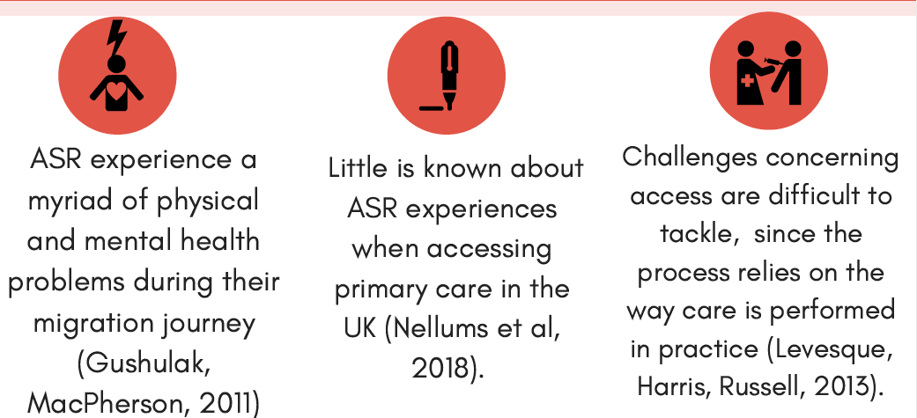
What we know:

Slide 4
Aim of the review:
To analyse the available literature from the UK to understand the experiences of ASR accessing primary healthcare.
Specifically, this literature review explored experiences of a) ASR and b) of professionals working with this group of people.

Slide 5
Methods and Methodology:
A critical interpretive synthesis was carried out. A comprehensive search on CINAHL Complete, Academic Search Complete, AMED - The Allied and Complementary Medicine Database, MEDLINE Complete, and PsycINFO and of grey literature resulted in the inclusion of 16 primary studies (13 qualitative, 2 mixed-methods articles and 1 quantitative article).

Slide 6
Search strategy
Review question: ‘What are the experiences of ASR accessing primary care in the UK?’
Key terms fitted in PICo which stands for Population, Issue, Context/ Comparison, Outcome (Aveyard, Payne, Preston, 2016).
Population is ‘ASR’,
issue is ‘access to primary healthcare’,
context is ‘the UK’
outcome is ‘experiences’
Notes:
The first search undertaken did not include the term ‘migrant’, as the aim of the paper was to look specifically at the experiences of ASR. It soon became evident that by excluding ‘migrant’ from the search, some relevant papers would be missed since the literature may refer to ASR as ‘vulnerable migrants’, ‘new migrants’, etc. Thus, the author decided to screen a larger number of articles and include only those which studied the experiences of ASR. This resulted in a better overview of the literature, especially since few articles explore the views of ASR or professionals working with ASR in the UK. The author hoped to find literature incorporating nurse’s views, but there was a clear gap in this area. Most literature comes from Canada, Australia and the United States, which if included would create potential inherent assumptions about ASR experiences which may not be applicable to the UK context. Nonetheless, articles from other countries were used in the synthesis of this review, as they may be a guide for future service improvement projects.

Slide 7
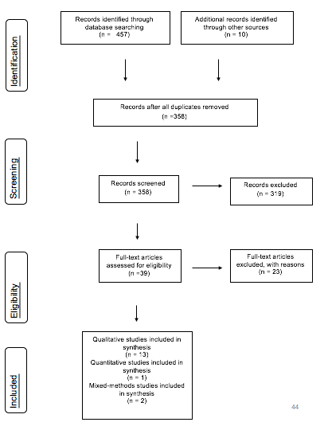
Prisma 2009 Flow Diagram
Qualitative, mixed-methods and quantitative studies were incorporated in the review if they:
(i) Included participants who were adult (over 18) asylum seekers and/or refugees (AS and/or R) living in the UK (England, Scotland or Wales);
(ii) Were published in the English language between 2007- 2019;
(iii) Explored the experiences of asylum AS and/or R accessing primary healthcare in the UK from the lens of ASR and/ or professionals working with ASR.

Slide 8
Critical Appraisal
Overall, all studies had some methodological flaws due to their small sample size, recruitment strategies and the nature of data collection and data analysis.
Most authors acknowledged these flaws when discussing the limitations of their studies, whilst some did not show enough reflexivity.
Lastly, although studies looked at experiences of staff working with ASR, not many included nurses as participants, which may limit the applicability of this review to nursing practice.
Notes:
One study (Nellums et al, 2018a) was written in conjunction with a NGO, and although it was valuable in terms of showing experiences of AS across the UK, the authors did not reflect on how their professional roles may impact on their findings, leading to possible, yet rarely acknowledged biases.

Slide 9
Entitlements to healthcare for ASR
Refused AS
In England: have to pay for secondary care
In Scotland + Wales: free primary+ secondary care
AS
For those AS waiting for a decision in the UK, the Government provides only £ 37.75 a week for each person in the household.
AS are also entitled to free dental treatment, prescriptions and eye tests after they apply for a fee waiver, also called ‘HC2’ certificate
R
The Government stops R financial support within 28 days, also referred to as the ‘move on’ period (Strang, Baillot, Mignard, 2018).
If an asylum case is rejected, any cash support ceases after 21 days (Bloch, 2013). Refused AS who meet certain criteria may receive £35.39 a week, redeemable at a limited number of shops through an ‘Azure’ card (Nellums et al, 2018).
In addition, the Government has introduced upfront charging for non-urgent care in 2015, deterring many refused AS from seeking care.
Free primary + secondary care

Slide 10
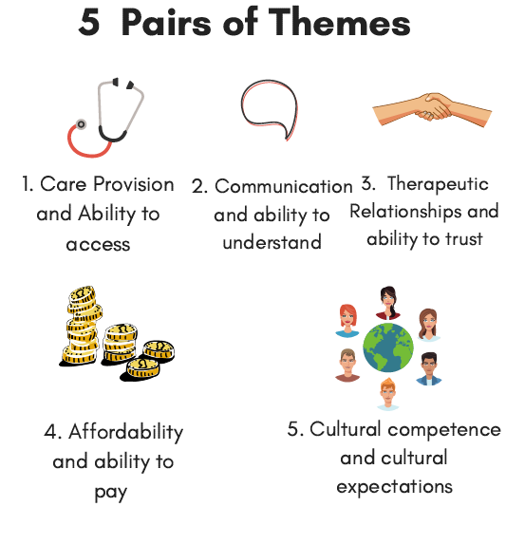
Findings:
Care provision, Communication, Therapeutic relationship, Affordability and Cultural Competence are themes used to describe the barriers and facilitators professionals working with ASR experience when providing care. Their pairs refer to barriers and facilitators ASR experience

Slide 11
Care Provision | Ability to access
Many constraints exists when trying to provide care due to a lack of understanding about the asylum system and healthcare entitlements for ASR (Lindenmeyer et al, 2016a; Balaam et al, 2015). Lack of resources and time (Robinson, Masoscha, 2017; Lindenmeyer et al, 2016a), lack of training (Nellums et al, 2018a; Burchill, Pevalin, 2014), high workload (Guhan, Liebling-Kalifani, 2011) and client's high expectations (Guhan, Liebling-Kalifani, 2011) were also cited as barriers to care. | These findings were mirrored in the perspectives of ASR who reported being unable to register with a GP (O’Donnell et al, 2008; Kang, Tomkow, Farrington, 2019). ASR lacked knowledge about the health system (O’Donnell et al, 2007; Fang et al, 2015) and complained being dispersed in areas where reaching a GP would be hard (Fang et al, 2015; Nellums et al, 2018a). Overall, ASR were dissatisfied with the slow paced health system, appointment system and treatment by reception staff The lack of continuity of care and of referral to specialists was seen as a barrier to accessing care (Fang et al, 2015; O'Donnell et al, 2007, 2008).

Slide 12
2. Communication and Ability to understand
Both staff and ASR reported language was a major barrier encountered in practice.
The use of interpreters = both a facilitator and barrier.
At times, the language barriers resulted in the wrong treatment being given to patients (Fang et al, 2015; Kang, Tomkow, Farrington, 2019).
Besides verbal barriers, ASR were dissatisfied with a person-centred approach, wanting GPs to take control instead of asking them what they thought was wrong (O’Donnell et al, 2008). They were also dissatisfied by the fact that consultations did not involve touching, which was often the case in their home country (O’Donnell et al, 2008).
Notes:
Staff reported that working with interpreters led to shorter appointments and often they were unsure whether translations were correct (Century, Leavey, Payne, 2007; Lindenmeyer et al, 2016a).
ASR felt they couldn´t trust interpreters or feared these would divulge sensitive issues with their community (Bernardes et al, 2011; Fang et al, 2015).

Slide 13
Therapeutic relationship | Ability to trust
Staff mentioned it was difficult to maintain boundaries with ASR, especially when they lived in the same area or town (Lindenmeyer et al, 2016a; Guhan, Liebling-Kalifani, 2011). Staff also felt they were ill-equipped in knowing how to build a therapeutic relationship with ASR (Balaam et al, 2015; Lindenmeyer et al, 2016a). | Regardless of participants’ birthplace, many mentioned a lack of trust in their GP. Lack of language, cultural understanding, use of computers, and brevity of consultations all impacted on the ability of ASR to trust staff (Fang et al, 2015; Kang, Tomkow, Farrington, 2019). Many ASR had no previous experience of primary care from their country of origin (Bhatia, Wallace, 2007).
Notes:
Situations where staff were able to build relationships with patients were viewed more favourably (Guhan, Liebling-Kalifani, 2011). Facilitators to building a therapeutic relationship included better resources, more training, more time and continuity of care (Nellums et al, 2018a; Guhan, Liebling-Kalifani, 2011). They complained about being discriminated against when booking appointments (O’Donnell et al, 2007; O’Donnell et al, 2008).
Positive accounts pointed out the benefits of having continuity of care.

Slide 14
4. Affordability and Ability to pay
Staff talked about the lack of resources and heavy caseloads that left little time for appointments (Guhan, Liebling-Kalifani, 2011; Robinson, Masocha, 2017).
They found the asylum system to be especially limiting and described how ASR were often unable to afford transport or medication (Robinson, Masocha, 2017; Balaam et al, 2015).
ASR reported similar concerns, especially when having to pay for over the counter medication and prescriptions (Fang et al, 2015; Nellums et al, 2018a). Even with a HC2 Certificate, ASR were asked to pay for their medication (Kang, Tomkow, Farrington, 2019).

Slide 15
5. Cultural competence and cultural expectations
It is important for staff not to make assumptions about culture
A lack of training in cultural competence leads to issues when planning and delivering care.
Disappointment in the delivery of care was the result of a mismatch between staff’s provision of services and expectations of ASR (Century, Leavey, Payne 2007; Lindenmeyer et al, 2016).
Notes:
Due to their pre-migration histories, ASR expected services to include the prescription of antibiotics and referral to specialists (Lindenmeyer et al, 2016a; Fang et al, 2015). In general, there was a lack of understanding about the role of the GP (Bhatia, Wallace ,2007; O’Donnell et al, 2008).

Slide 16
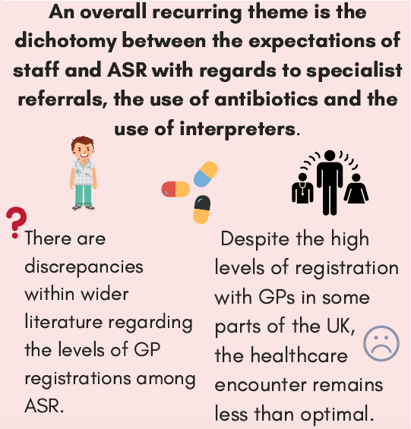

Results within wider literature
Notes:
Interestingly, both staff and ASR complain about similar barriers to care. This highlights that, although research from the UK relates to a small sample, the findings have value in terms of understanding the experiences of ASR. Furthermore, staff recall similar findings to those of ASR, which reinforces the validity of results.
It may be argued that due to a lack of trust, ASR consider practitioners to be part of a discriminatory system, whilst staff see themselves bound by legal and systemic regulations beyond their influence. Better communication channels between practitioners and patients may be needed to balance expectations and improve rapport between the two groups.
There are discrepancies within literature regarding the levels of GP registration among ASR. Considering healthcare in the UK is devolved, it should not come as a surprise that access to healthcare might differ by region. Indeed, according to studies undertaken in Scotland (O’Donnell et al, 2007; Mulvey, 2013) many ASR are registered with a GP and access healthcare regularly. However, evidence from other parts of the UK suggests a different picture (Stagg et al, 2012; Bhatia, Wallace, 2007). This may indicate that ASR in England are less likely to access healthcare compared to those living in Scotland, which could possibly be pinned down to the fact that ASR in Scotland receive free secondary care. Moreover, the city of Glasgow, has been one of the largest dispersal sites for AS. Between 2013 and 2016, all new refugees in Scotland were eligible for up to twelve months support from the Holistic Integration Service, including help with language, and support for those with complex needs (Strang, Baillot, Mignard, 2018).
The commonalities and disparities in literature show that factors influencing access to healthcare are fluid in nature. Hence, questioning the ways in which research has measured access is important in understanding whether findings are based on assumptions which are transferrable across studies (Dixon-Woods et al, 2006). If assumptions are based on findings from literature, this does not automatically mean they should be taken at face value over time. For example, the assumption that ASR are not accessing primary care in the UK might change once services become less restrictive. Thus, if some assumptions are inherently wrong and these are propagated within research, subsequent studies might inherit flaws.

Slide 17
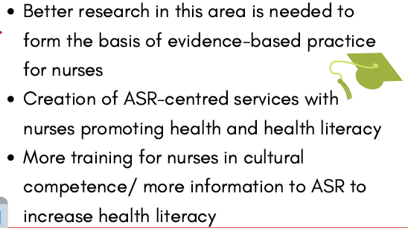
Implications for practice

Slide 18
What would a service improvement look like?

Slide 19
References
Apostolidou, Z., Schweitzer, R. (2017) ‘Practitioners’ perspectives on the use of clinical supervision in their therapeutic engagement with asylum seekers and refugee clients’, British Journal of Guidance and Counselling, 45 (1), pp. 72-82.
Apostolidou, Z. (2015) ‘Politicised notions of professional identity and psychosocial practice
among practitioners working with asylum seekers and refugees’, British Journal of Guidance and Counselling, 43 (4), pp. 492-503.
Arshad, F., Haith-Cooper, M., Palloti, P. (2018) ‘The experiences of pregnant migrant women in detention: A qualitative study’, British Journal of Midwifery, 26 (9), pp. 591-596.
Aveyard, H., Payne, S., Preston, N. (2016) A Postgraduate's Guide To Doing A Literature Review In Health And Social Care (1st edn). Berkshire: Open University Press.
Baalaam, M. C., Kingdom, C., Thomson, G., Finlayson, K., Downe, S. (2015) ‘’We make them feel special’: The experiences of voluntary sector workers supporting asylum seeking and refugee women during pregnancy and early motherhood’, Midwifery, 34, pp. 133-140.
Bales, S., Sare, L. (2014). ‘Refining Strategy: A Second Bid at Critical Interpretive Synthesis for Collection Building’, Qualitative and Quantitative Methods in Libraries (QQML), 1, pp. 141-151.
Barrington, A. J., Shakespeare-Finch, J. (2013) ‘Working with refugee survivors of torture and trauma: An opportunity for vicarious post-traumatic growth’, Counselling Psychology Quarterly, 26 (1), pp. 89-105.
Basedow J, Doyle, L. (2016) Refugee Council England’s forgotten refugees: Out of the fire and into the frying pan, Available at: https://www.refugeecouncil.org.uk/assets/.../England_s_Forgotten_Refugees_final.pdf (Accessed 04 April 2019).
Beeres, D. T., Cornish, D., Vonk, M., Ravensbergen, S. J., Maeckelberghe, E. L. M., Van Hensbroek, P. B., Stienstra, Y. (2018) ‘Screening for infectious diseases of asylum seekers upon arrival: the necessity of the moral principle of reciprocity’, BMC Medical Ethics, 19 (16), Available at: https://bmcmedethics.biomedcentral.com/track/pdf/10.1186/s12910-018-0256-7 (Accessed 20 April 2019).
Bernardes, D., Wright, J., Edwards, C., Tomkins, H., Dlfoz, D., Livingstone, A. G. (2010) ‘Asylums Seekers’ Perspectives on their Mental Health and Views on Health and Social Services: Contribution for Service Provision using a Mixed-Methods Approach’, International Journal of Migration, Health and Social Care, 6 (4), pp. 3-20.
Betancourt, J., Green, A., Carillo, J. (2002) Cultural competence in health care: emerging frameworks and practical approaches. The Commonwealth Fund, Available at: https://www.commonwealthfund.org/publications/fund-reports/2002/oct/cultural-competence-health-care-emerging-frameworks-and (Accessed 22 April 2019).

Slide 20
Bhatia, R., Wallace, P. (2007) ‘Experiences of refugees and asylum seekers in general practice: a qualitative study, BioMedical Central Open, 8 (48), Available at: https://www.ncbi.nlm.nih.gov/pmc/articles/PMC2001193/ (Accessed 6 April 2019).
Bloch, A. (2013). ‘Living in fear: rejected asylum seekers living as irregular migrants in England’, Journal of Ethnic and Migration Studies, 40 (10), pp. 1507-1525.
Burchill, J., Pevalin, D. (2014) ‘Demonstrating cultural competence within health-visiting practice: working with refugee and asylum-seeking families’, Diversity and Equality in Health and Care, 11, pp. 151-159.
Burchill, J., Pevalin, D. (2012) ‘Barriers to effective practice for health visitors working with asylum seekers and refugees’, Community Practice, 85 (7), pp. 20-23.
Care and Quality Commission (CQC, 2018) York Street Health Practice Inspection report 20/11/2018, Available at: https://www.cqc.org.uk/location/1-3705684815 (Accessed 22 April 2019).
Century, G., Leavey, G., Payne, H. (2007) ‘The experience of working with refugees: counsellors in primary care’, British Journal of Guidance and Counselling, 35 (1), pp. 23- 40.
Dixon-Woods, M., Agarwal, S., Jones, D., Young, B., Sutton, A. J. (2005) ‘Synthesising qualitative and quantitative evidence: a review of possible methods’, Journal of Health Services Research and Policy, 10 (1), pp. 45-53.
Dixon-Woods, M., Cavers, D., Agarwal, S., Annandale, E., Arthur, A., Harvey, J., Hsu, R., Katbamna, S., Olsen, R., Smith, L., Riley, R., Sutton, A. J. (2006) ‘Conducting a critical interpretive synthesis of the literature on access to healthcare by vulnerable groups’, BMC Medical Research Methodology, 6 (35), Available at: https://doi.org/10.1186/1471-2288-6-35 (Accessed 26 April 2019).
Gov.UK (2019a) Guidance NHS entitlements: migrant health guide, Available at: https://www.gov.uk/guidance/nhs-entitlements-migrant-health-guide (Accessed 11 March 2019).
Immigration and Asylum Act 1999 (c33, part IV). Available at: https://www.legislation.gov.uk/ukpga/1999/33/section/95 (Accessed 04 April 2019).
Robertshaw, L., Dhesi, S., Jones, L. L. (2017) ‘Challenges and facilitators for health professionals providing primary healthcare for refugees and asylum seekers in high-income countries: a systematic review and thematic synthesis of qualitative research’, British Medical Journal Open, 7 (8), e015981, Available at: 10.1136/bmjopen-2017-015981 (Accessed 26 April 2019).

