Slide 1
Beyond a dissertation
By Raluca Vagner
MSc Adult Nurse Student
Oxford Brookes University

Slide 2
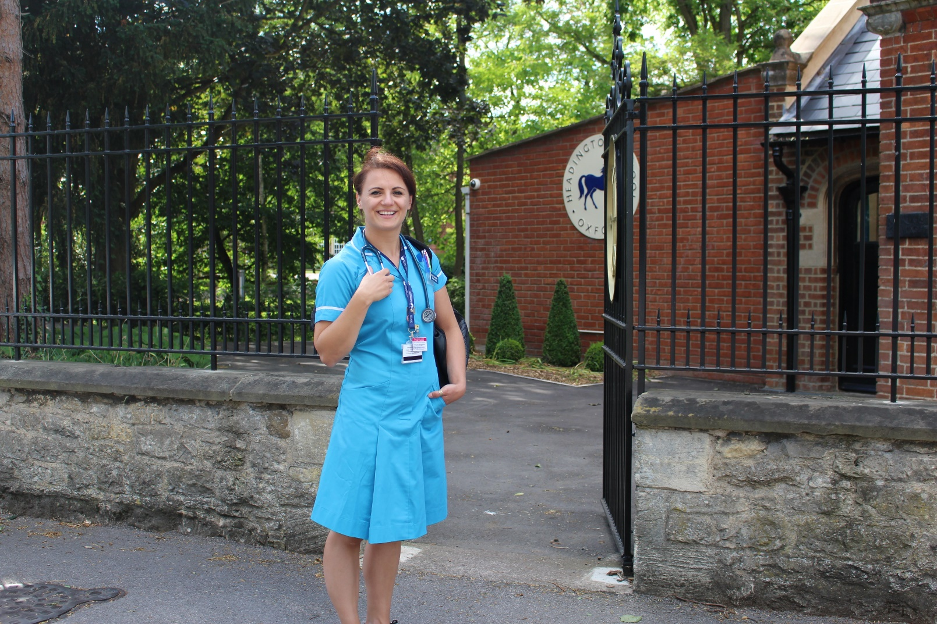
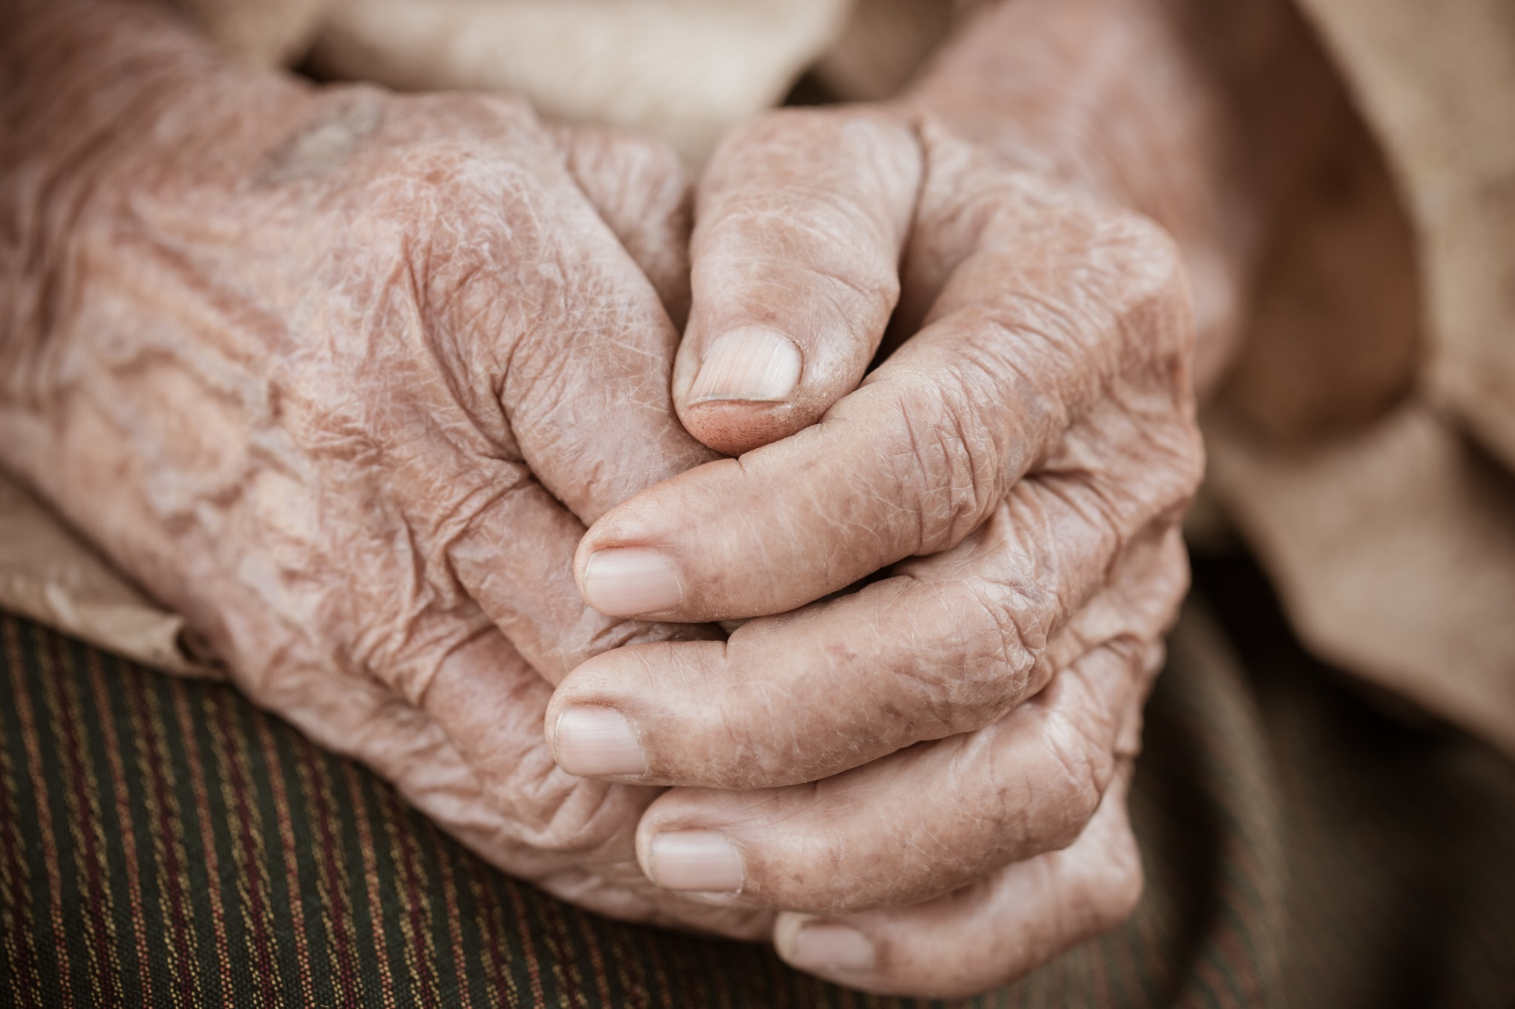
STUDENT NURSE
Notes:
I started my nursing degree almost three years ago…. Remember that first day of placement?.... First placement (with freshly ironed uniform and loads of pens) – vascular surgery. Brilliant mentor, she’d been there for 11 years. Slowly the reality of disease really hit me. I saw people loosing limbs due to disease most weeks and I was gobsmacked. Especially as some of these patients were young as well …early 50s, with families at home. I specifically remember one gentleman who had an emergency amputation. I was on a long shift and I went nice and early to introduce myself…I will never really forget him. First bed on the right in a bay of four, sitting up and looking lost. I was trying to gage how he was…He said he is a fireman and went to the GP the previous day – then blue-lighted to the hospital. He woke up to no leg…He was meant to go to his son’s wedding the following weekend… He felt suicidal…

Slide 3
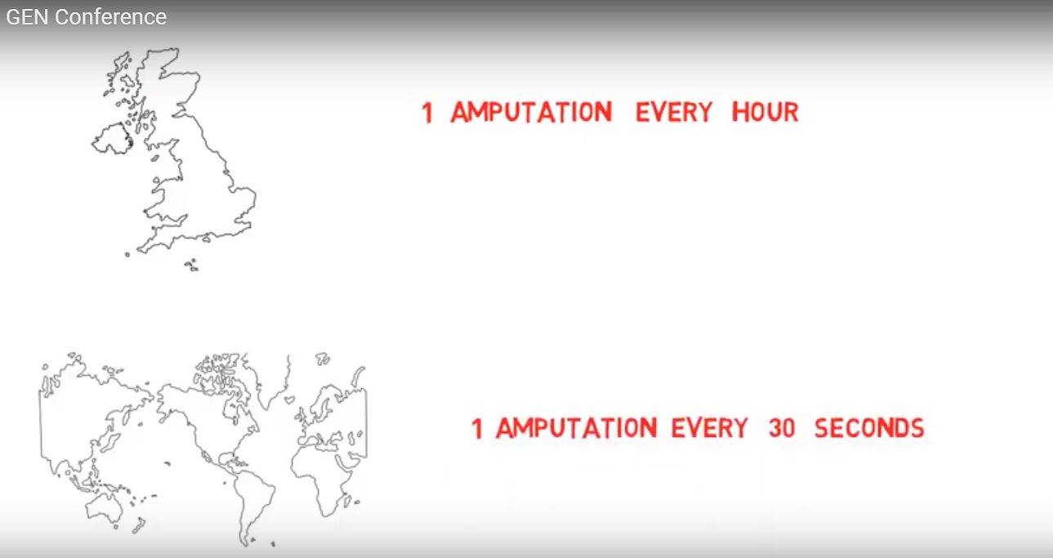
AMPUTATIONS…
Notes:
I later found out that diabetes is responsible for one amputation almost every hour in the UK, that there is an amputation every 30s worldwide…

Slide 4
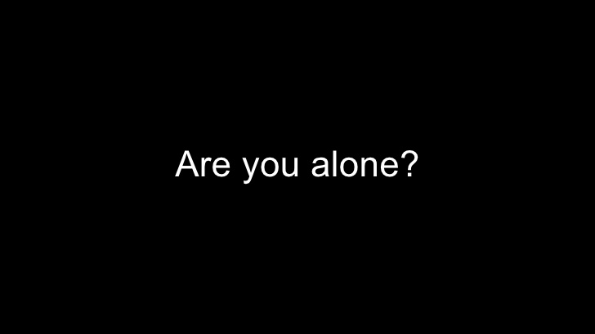
Notes:
To say I felt sad, out of my comfort zone and desperately useless is an understatement. So, with my enthusiastic first year nursing student hat on I went to my mentor. Ok, amputations happen, but what do we do after. I see my patient is fit for discharge, but he said he will overdose when he goes home…What are we doing about that?...the answer was unexpected ‘A psych referral’. I wasn’t satisfied with this alone, as I know how much pressure the MH sector is under so it was then when I wanted to understand what happens when all the amazing support from hospital is stopped and people are discharged home. What is it put in place to support our patients through this?

Slide 5
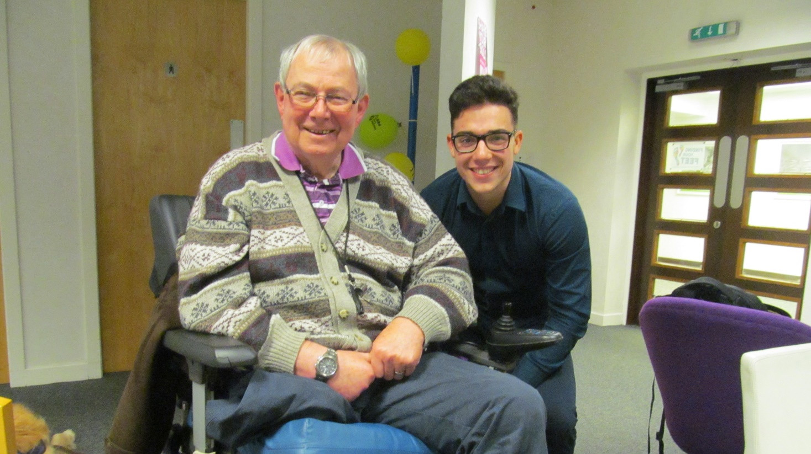
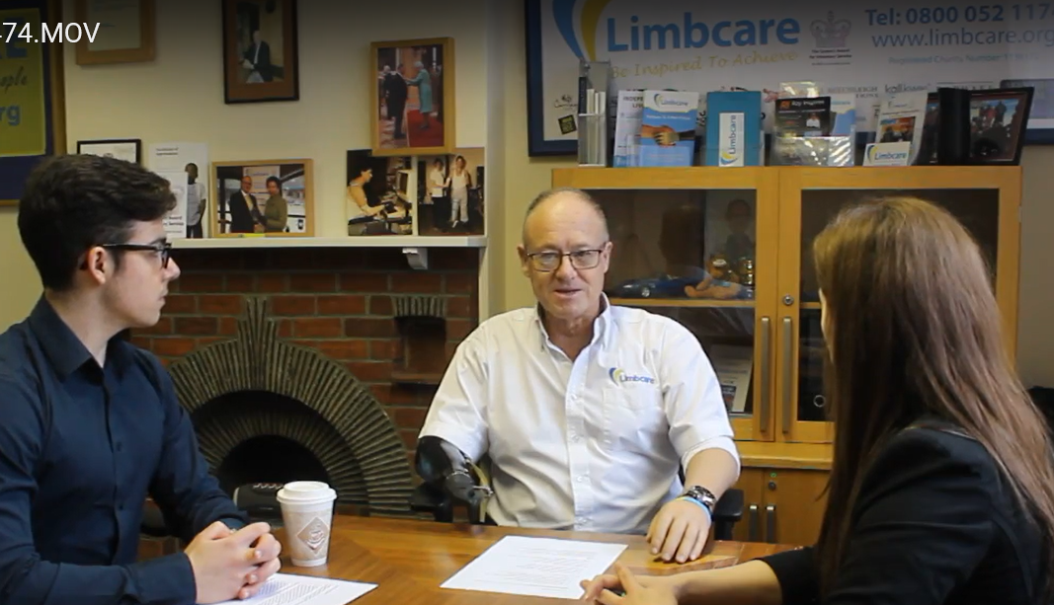
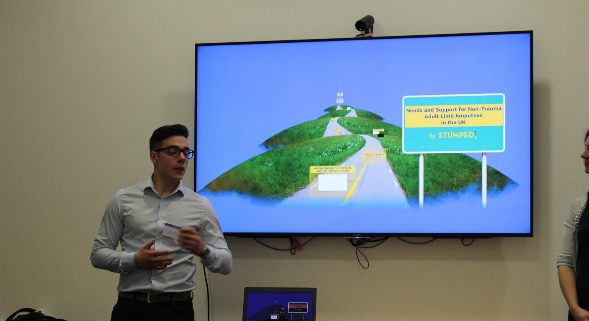
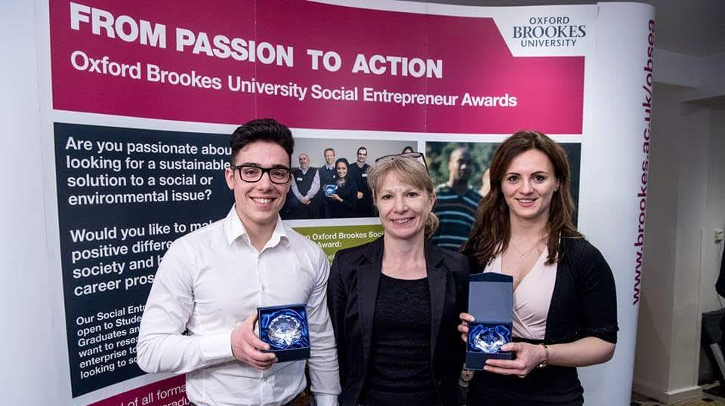
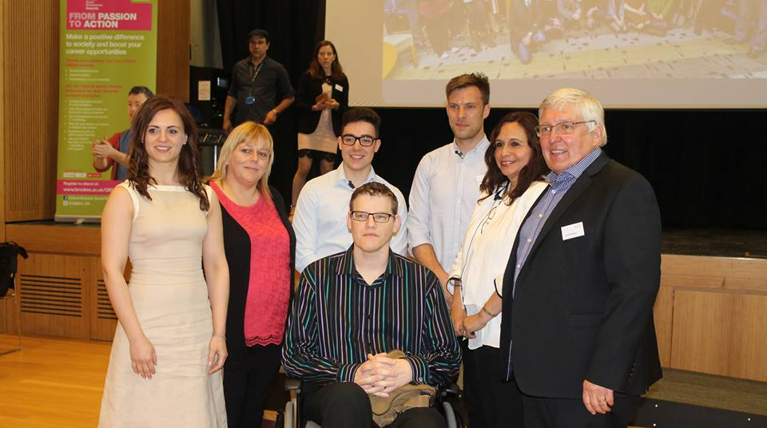
SEARCHING FOR ANSWERS
Notes:
So, I convinced my colleague, Pedro (whom some of you might have met) to actually go and find out. We scratched for money and were granted two awards from Oxford Brookes Social Entrepreneurship Awards to go and explore this area. We called all the entities in the UK to see what sort of support they offer people after amputation and we were lucky that some of those entities said they will meet us and explain more. We went to Glasgow to chat to them and some amputees who were in receipt of fantastic support from a local charity. But the more we digged, the more we found. We were overwhelmed and there was a theme that kept on coming back again and again…’if only I have known about the support available earlier, it would have saved me months or years of thinking I am alone in this’. So, with about £3000 in our pockets we decided to put that in an website, all those amazing stories and entities and info that we found, so that others can access as well….

Slide 6
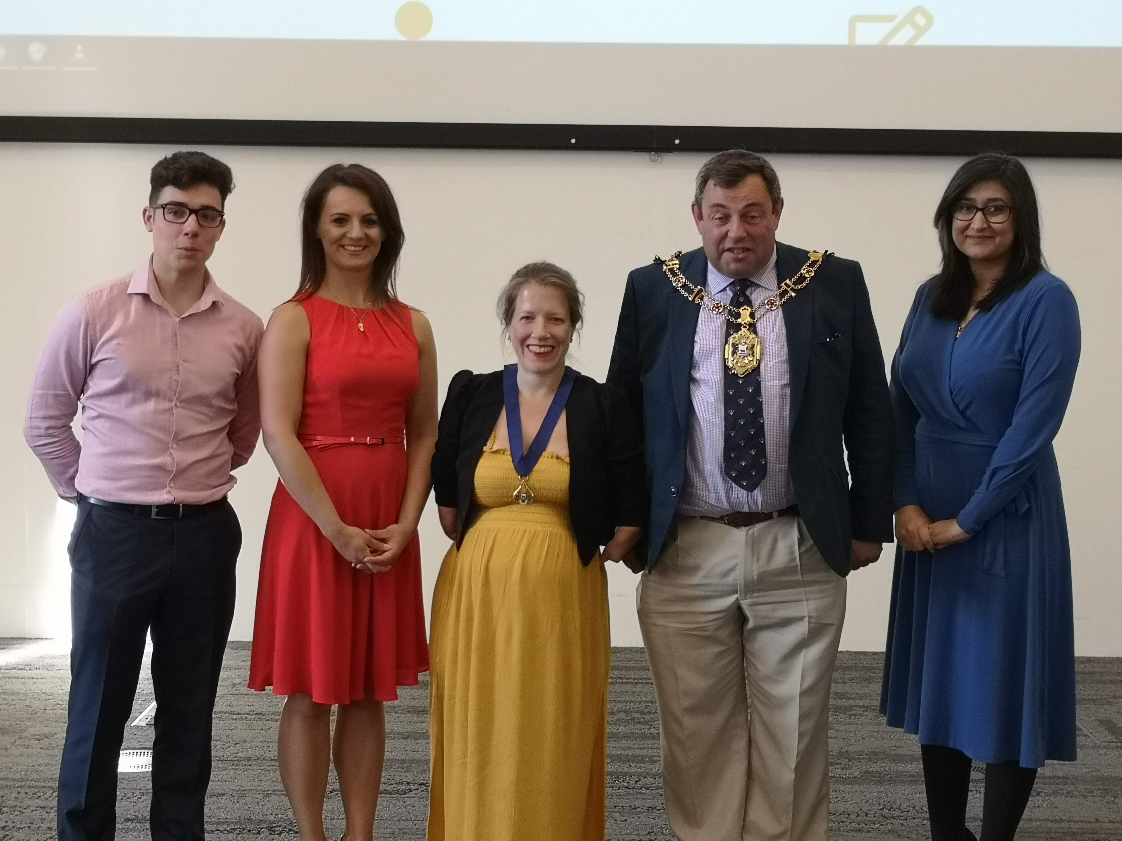
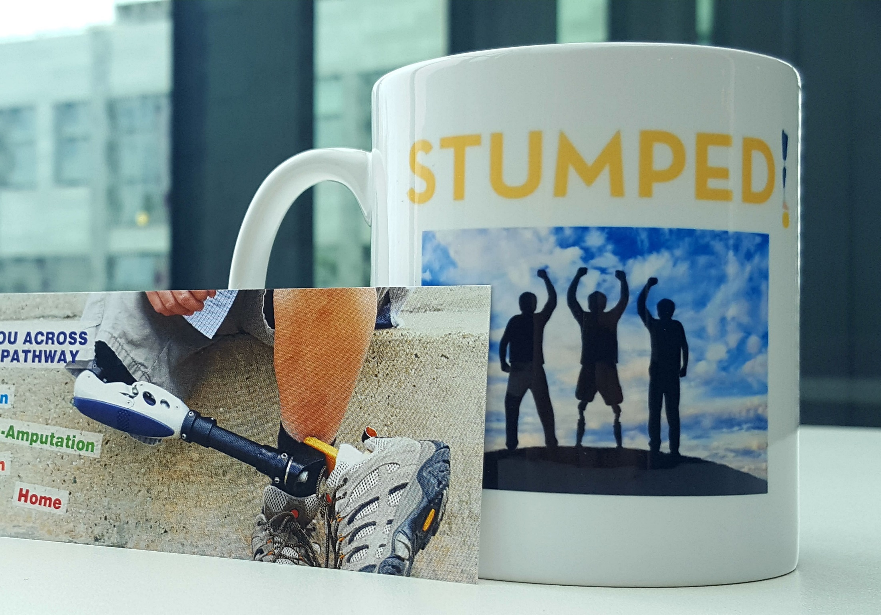
STUMPED.ORG.UK (www.stumped.org.uk)
Notes:
But it was again, overwhelming. Having never created a website, to actually know what should go on a website and it was a bit tricky…so. I have submitted an application to Student Leadership Programme, an innovative programme run by Council of Deans of health tailored to the healthcare arena. I was one of the 150 people across the country and across disciplines to be chosen to take part. I went to it with an agenda though, because I was still passionate to share my findings regarding amputees. But what happened was beyond my expectations…the council arranged that I was mentored by an amazing national patient representative – a double amputee who besides knowing everything about amputations and services, he is an incredible person! What more could I ask. So with Steve’s guidance, Pedro and I started to shape the website and slowly add content on it. The website had been launched in Oxford, with Lord Mayor of Oxford inaugurating it!

Slide 7
Evaluation of a one-stop website for lower-leg amputees and clinicians: a usability study
RESEARCH QUESTION
To what extent is Stumped! website’s design, functionality, and usability appropriate for the target audience?
Notes:
We rely on other professionals to add content on the website and that entails extremely good communication skills and lots and lots and lots of persuasion to give up their time…But we also had feedback saying that websites are not the right mean of communicating this information, that we are wasting our time or reinventing the wheel. So we decided to do our dissertations on this…I have decided to run a usability study to test is Stumped! website’s design, usability and functionality are in line with the target audiences experience and expectations.

Slide 8
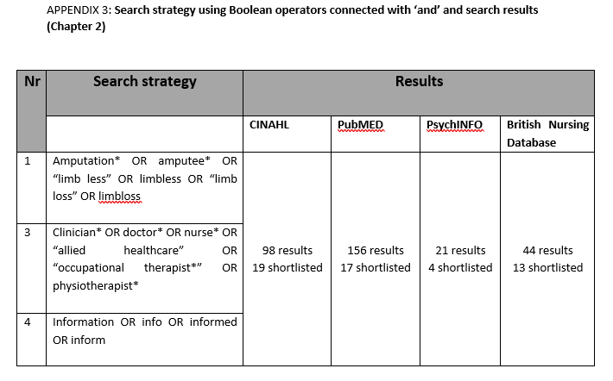
LITERATURE REVIEW
SEARCH STRATEGY
Notes:
Prior to starting to collect the data needed to answer my question, I searched the databases to check what information people actually want? This was in an attempt to inform the website’s design and evaluation. I realised early on that the evidence is scarce, but went ahead, nonetheless.
I conducted the literature review in a systematic manner, running this (box) search on 4 databases. This resulted in 284 articles (after removing duplicates). After reading the title and abstracts of all the resulted articles, 42 were selected as relevant. A further screening was conducted on the shortlisted articles by reading them in their entirety to ensure they address the research questions either as a primary or as an additional result. Furthermore, snowball sampling (Lewis-Beck, Bryman and Liao, 2004) was used by analysing the respective reference lists and additional sources. All eligible articles (n=14) have been assessed for quality by using: CASP tool (Critical Appraisal Skills Programme, 2018) for literature review and qualitative studies, and Cadwell, Henshaw and Tylor (2011) for quantitative studies (Appendix 6). The main exclusion criteria imposed was adherence to ethical considerations. This resulted in three articles being removed.

Slide 9
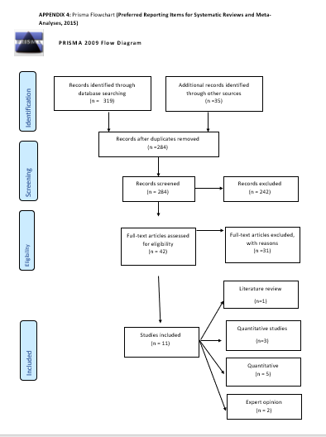
PRISMA FLOW CHART

Slide 10
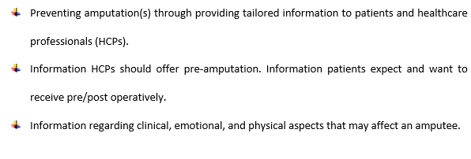
LITERATURE REVIEW – RESULTS
Notes:
My literature review outlined three themes:
Preventing amputation(s) through providing tailored information to patients and healthcare professionals (HCPs).
Information healthcare professionals should offer pre-amputation. Information patients expect and want to receive pre/post operatively.
Information regarding clinical, emotional, and physical aspects that may affect an amputee.

Slide 11

LITERATURE REVIEW – RESULTS
Discrepancy
Disappointment
Prevention
Grieving stages
Notes:
In summary, this literature review highlighted a discrepancy between what amputees need and what HCPs think amputees need to know. This was across the stages of amputations and most prevalent post amputation. An example relates to phantom phenomena. Two articles, one focusing on patients and one on HCPs outline that amputees would like to know about phantom phenomena, but the reality is that they are mainly told about it by other patients in the bay. From HCPs perspective, they acknowledge that informing patients about phantom phenomena is important, but no profession took accountability, always thinking is someone else’s duty. This experience left patients with a sense of disappointment.
Prevention was seen as crucial step in the pathway and peer support was deemed crucial.
And finally, acknowledging that loosing a limb mirrors the grieving stages gives HCPs a framework to work within, whilst supporting not only the patient, but also their family.

Slide 12
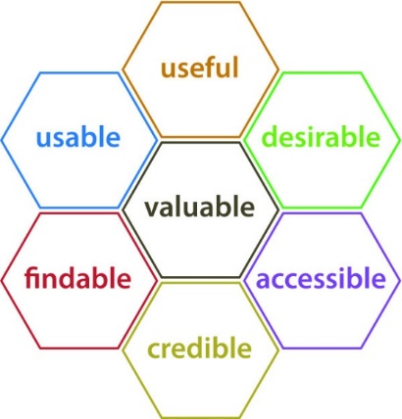
Evaluation of a one-stop website for lower-leg amputees and clinicians: a usability study
a technique of exploring whether a software product is fit for purpose, through observing users interacting with it in meaningful and realistic situations. (Barnum, 2011)
User experience honeycombe (Morville and Resenfeld, 2006)
Notes:
Geared with this newly found information (partly confirming what I found by talking to amputees and other professionals), I went on to do my primary research. And this was not an easy task. Firstly ethics, which was…ethics…..this was granted in October 2018 and then the data collection.
So, I have conducted a usability study. This basically means that I have recruited participants that will use the website whilst I assess its design, functionality and usability. And I will expand on this in a little bit.

Slide 13
SAMPLE SIZE – usability study
5 participants = 77% errors
10 participants = 80% errors
Faukner (2003)
Virzi (1992), Nielsen and Landauer (1993), and Lewis (1994)
MY STUDY:
Participant sample:
3-7 amputees / 3 amputees
3-7 clinicians / 6 clinicians
Notes:
As this was a usability study, the literature explains that there is no need for vast participant sample. Actually, a study by Faukner (2003) found that five participants are likely to identified 77% of problems and ten participants 80% of problems. These results are in line with Virzi (1992), Nielsen and Landauer (1993), and Lewis (1994). Therefore, after discussing this topic with my two supervisors (one from Healthcare and the other one from Technology Design and Environment), we decided to aim and recruit 3-6 amputees and 3-6 HCPs.
The usability study was due to have two phases: phase 1: identify any issues and make the changes; phase two: same tasks, new participants – and see what happens. Due to time restrictions and participants, only phase one has been conducted.

Slide 14
HOW DID I GET MY DATA?
One-to-one sessions lasting max 1h
Tasks to completed (six amputees; seven healthcare professionals)
TOOLS
Qualitative
- think-aloud protocol
- field notes
- debriefing
Quantitative
Pre-task questionnaires
Post-task questionnaires (System Usability Score)
Structured observations: clicks, time; frustration levels.
Notes:
I have oragnised one to one sessions with all participants lasting maximum of an hour
During this sessions, I have given the participants six – seven tasks (example). I have used both qualitative and quantitative tools:

Slide 15
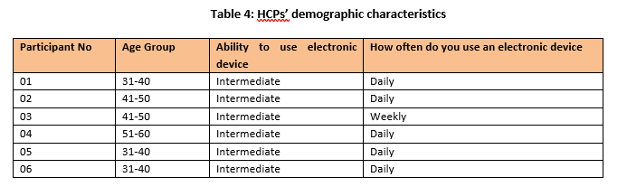
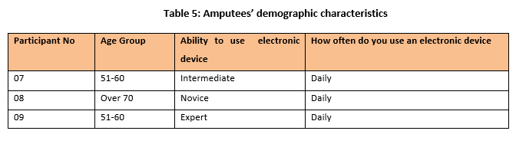
RESULTS – Quantitative- Pre task questionnaire
Notes:
All HCPs self-reported as being able to use an electronic device at an intermediate level, with 83.33% reporting daily use, whilst 16.67% reported weekly use of electronic devices. The amputees reported being at all three levels, respectively: novice, intermediate, or expert. The HCPs were aged 31-60, with 50% being in the 31-40 category, 33.33% 41-50 and 16.67% 51-60. The amputees were aged 51-over 70 years old, with 66.67% being between 51-60 years old.

Slide 16
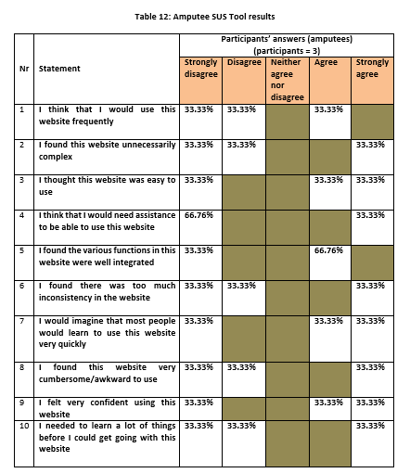
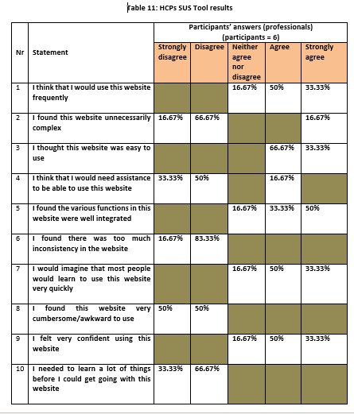
RESULTS – Quantitative- Post task questionnaire (SUS)
Notes:
HCP’s For the HCPs, the results of this questionnaire highlighted that 83.33% of participants believe that they will use this website frequently, with 100% considering it easy to use and straightforward. Most participants felt confident in using the website (83.33%) and considered the functions well integrated. However, 16.67% were undecided as to whether they are confident using the website, that the functions were well integrated, and that people will learn how to use it quickly.
Amputees: These results show a clear discrepancy, as one participant’s feedback is mainly opposite to the other two participants’ results. Only 33.33% of participants consider that they will be using this website frequently, despite 66.66% participants finding it easy to use. One participant considered the website difficult to use, with increased inconsistencies. Contrarily, most participants (66.67%) considered themselves confident in using the website, further considering that others will learn to use it easily.

Slide 17
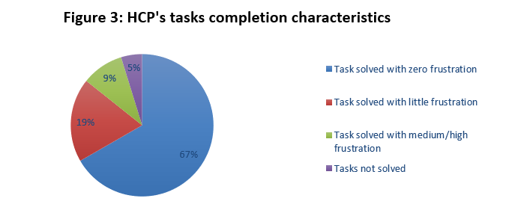
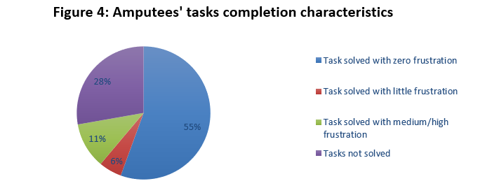
RESULTS – Quantitative- Structured observations
Notes:
Whilst 95.24% of tasks were completed successfully by HCPs, only 72.22% were completed by amputees. HCPs presented 9.52% medium/high frustration on completing the tasks. Amputees’ level of frustration exceeds 28%, with one participant registering high level of frustration whilst completing four out of the six tasks. HCP’s exhibited little frustration in 19.04% of the tasks, whilst amputees in 5.55% of tasks. Furthermore, the majority of HCPs (66.68%) did not experience any frustration, whereas only 55.56% amputees had not displayed any frustration.

Slide 18
Quantitative – discrepancies
? High frustration = completed task
? Low frustration = failed task
12 click = medium frustration
4 clicks = maximum frustration
30 clicks = low frustration
6 tasks = maximum frustration
one participant’s feedback is mainly opposite to the other two participants’ results.
Notes:
a potential lack of correlation between the levels of frustration observed and the failed tasks. Both HCPs and amputees who failed task a task have an average score that demonstrates little frustration (0.5, respectively 1). However, HCPs despite completing tasks three and four both have reached the maximum level of frustration.
the number of clicks and the level of frustration for both amputees and HCPs. HCP 1 clicked 12 times to reach the information required and presented medium/high frustration, whilst HCP 2 clicked 4 times before reaching maximum level of frustration. Amputee 7 clicked 30 times and expressed little frustration, whereas amputee 8 clicked 6 times before abandoning the task.

Slide 19
RESULTS – Qualitative – Thematic analysis
Theme 1: Design/usability/functionality
Theme 2: Purpose
Theme 3: Content
Theme 4: Intended users
‘Fairly easy to use’
‘Sensible terminology’
Prior experience (or lack of)
Technical errors or suggestions
Moral duty & Setting expectations
Guide and signpost
Comprehensive and tailored content
Relevant and useful
‘Those who can will definitely use technology more’
Notes:
“you kind of have some good headings which direct you… and…things like ‘For You’ or ‘For HCPs’, I don’t need to necessarily…hmmm…if I was a healthcare professional I wouldn’t even perhaps go to ‘For You’…But if a patient was asking something about the service, I could easily just sort of eliminate…choose my route quite easily…So I thought that was really good” (Participant 5, HCP); “It’s just straight forward plain English” (Participant 9, Amputee). “The only thing I would say is that ‘Question and answers’… that didn’t spring out to me. Whether because it was ‘FAQs’ and ‘questions and answers’…... I would actually write that. But that’s just me…. Yeah…cause I don’t think that older people might…I didn’t recognise that.” (Participant 3, HCP).
PREVENTION:“For them to see the word ‘Prevention’ and ‘Amputation’ together it’s really powerful I think. Because they are not going to go away thinking amputation is a given because all those people in the waiting room have it… So the word ‘Prevention’ is definitely definitely important.” Conversely, participant 5 (HCP) said: “….I think what probably throw me off was a little bit the ‘prevention’ thing cause I thought ‘well actually, if you already had amputation…. ermm it’s sort of… too late?”. This aspect will be addressed in Chapter 5: Discussion. “Like I have said: guiding you across the care pathway…. That’s a positive thing” (Participant 2; HCP).
“I think perhaps now the patients who are perhaps in their 80’s may not you know will definitely use a mobile phone, some of them would use a smart mobile, most of them may not perhaps have a tablet. But everyone who’s in their 60s will have tablet or an I-pad will definitely have a smart phone, will know what internet is. You will use services like ordering their repeat prescriptions online, or appointments, use an online calendar …and so… perhaps population is obviously aging… but I think in the sort of next 20 years the individuals who will be 80 would have grown up with reasonable internet access and they will be able to use it…you know… of course you know provide dexterity, cognition eyesight all those things. But I think for those who can they will and definitely people use technology more” (Participant 5; HCP).

Slide 20


WHAT DOES IT ALL MEAN?
There is a need for this resource
Website’s usability
Importance of centralised information
Unique contribution
Planned changes
Notes:
The aging population targeted by this website was highlighted as a consideration, but not as an obstruction. My research showed that people with limited computing skills often employ various adaptive techniques to overcome this challenge. Therefore, those less skilled participants have recognised others in their network who can assist with using electronic devices. Furthermore, HCPs clearly identified through their clinical experience, a shift towards a more digitally aware patient group.
SUS Tool: 100% HCP and 66.66% of Amputees stated that the website was easy to use

Slide 21
WHAT NOW?
Limitations
Recommendations for research and practice
Reflections
Notes:
Time restrictions
Novice researcher and own involvement
Subject investigated
Participants

Slide 22
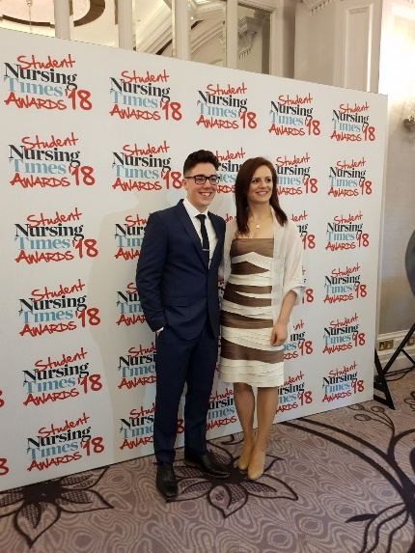
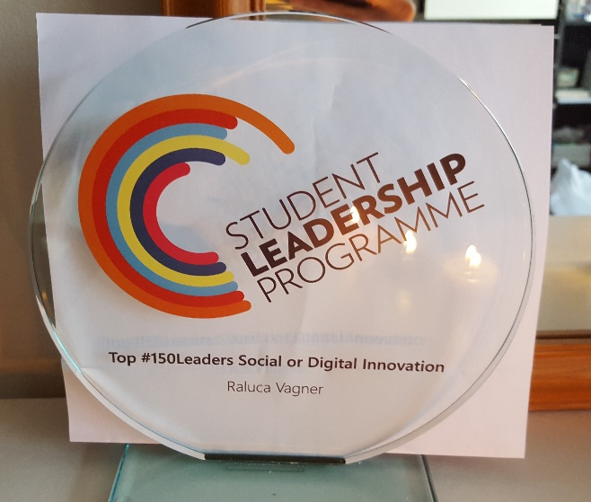
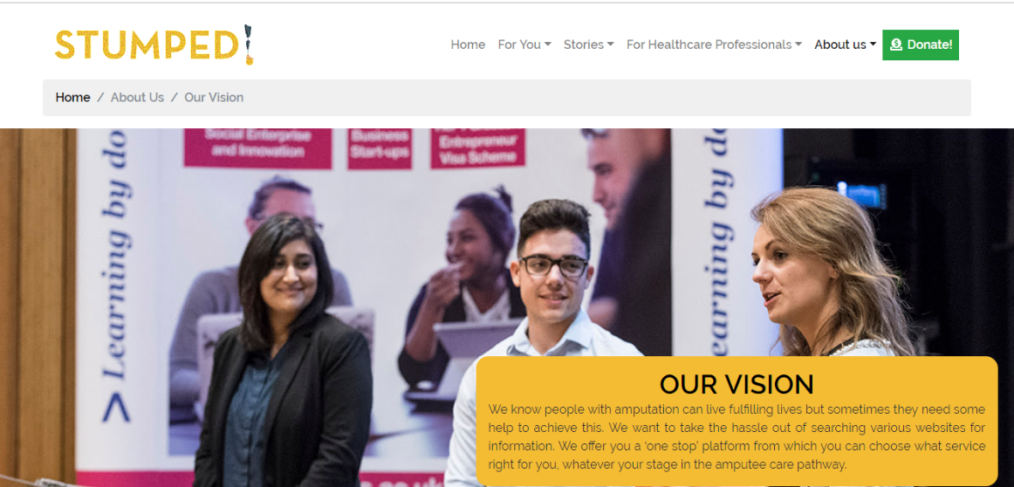
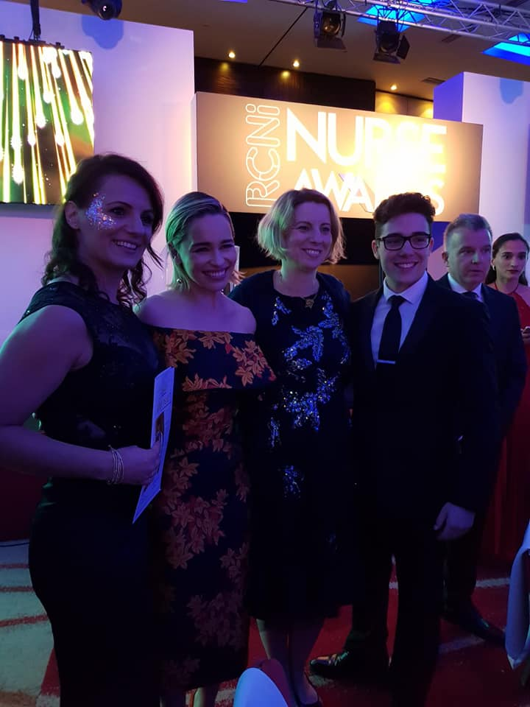
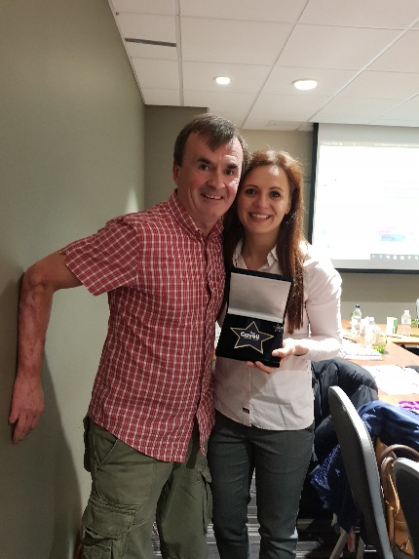
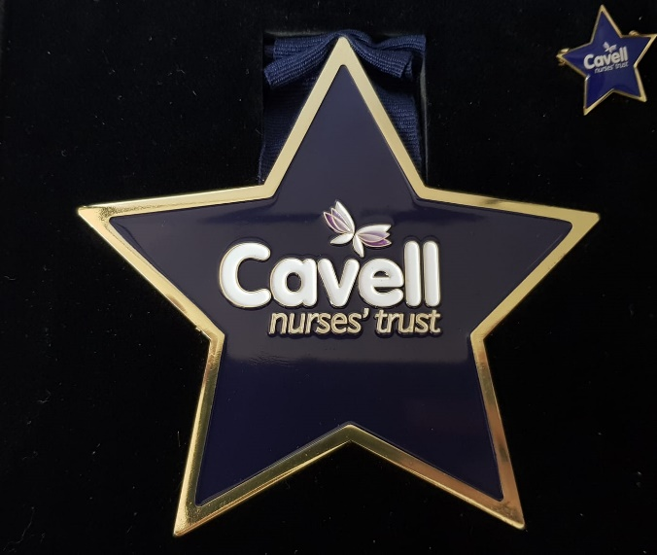
WWW.STUMPED.ORG.UK

