Slide 1


Innovative Approaches to Learning in Practice Bitesized Teaching: Educational Futures for Mental Health Training Mr Sam Thompson – Senior Mental Health Practitioner Dr Ryan Dias – Leadership Fellow Dr Robert Bartram – Specialty Doctor

Slide 2

Background
Part of the GEN 1401 at Nottingham University
Graduated in January 2016, working on mixed adult acute ward in Derbyshire
Stumbled across ‘Bitesized Teaching’ – interest in physical health
Worked in CAMHS inpatient for 1 year
Travelled to Australia, worked in adult PICU and CAMHS inpatient ward in Sydney
Returned to the UK to do Cognitive Behavioural Therapy training in CAMHS
Collaboration with Health Education England.
Notes:
Initial Bitesized Teaching session – hyper/hypoglycaemia. Loved the concept/idea
Developing the learning resources/logo/youtube video/information for the website

Slide 3
Concept
Brief tutorials on physical health problems, to Nursing Staff and Healthcare Assistants
Session delivered at afternoon ward handover once a week
2 sets of ward staff will be present (morning and afternoon)
Session to last no more than 10 minutes
Will not have access to powerpoint to present
will be a verbal presentation + handouts
Notes:
Physical health vs mental health Parity of Esteem

Slide 4
Teaching
Each session will cover the following areas:-
Signs
Symptoms
Causes
Basic ward level management
Each ward receives 1 session per week

Slide 5

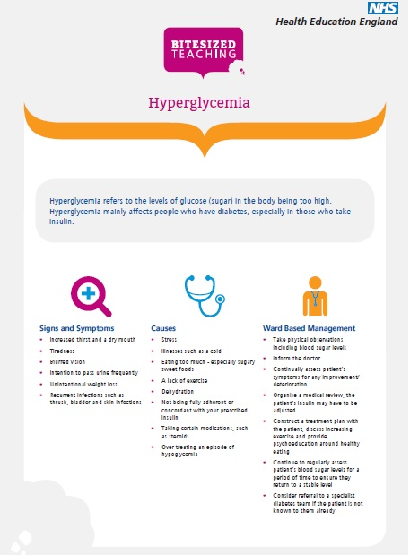

Slide 6
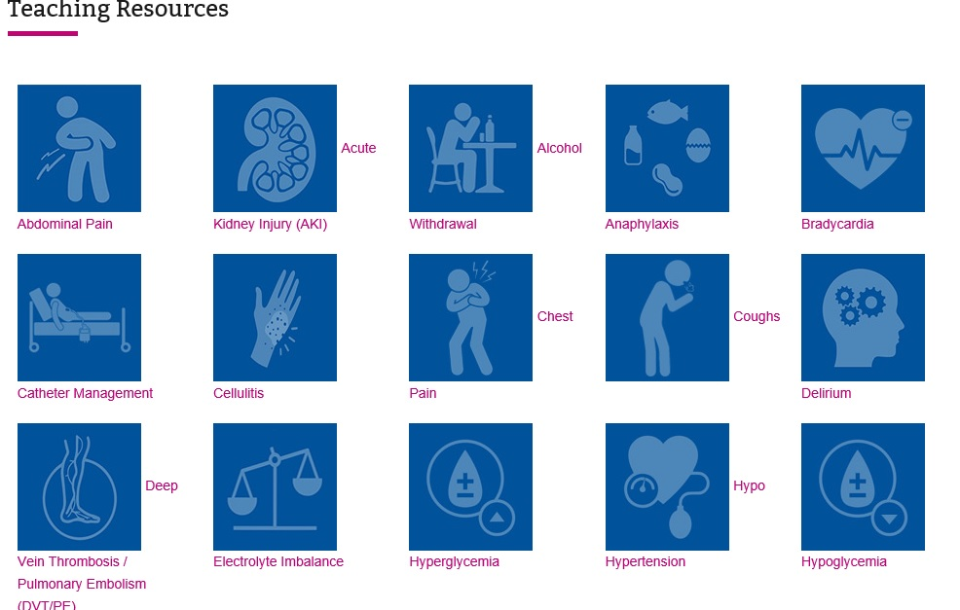

Slide 7
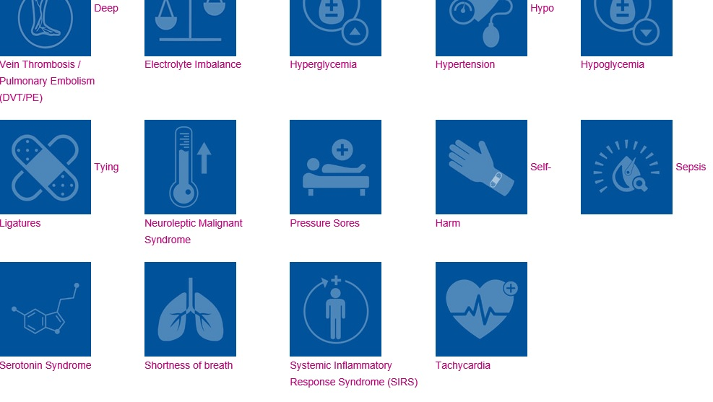

Slide 8
Benefits
‘High impact’ learning through streamlined aims and objectives
Refresh and enhance existing clinical knowledge
Maximum participation and minimal impact on the working day
Informal teaching environment
Enhanced working relations between junior doctors and other ward staff
Teaching opportunities for the junior doctors as part of their training development

Slide 9
Additional benefits
Very easy to set up
No outlying costs
Simple and flexible format
Timeslot for delivery already exists
Junior doctors as ready and able teaching resource
Curriculum already exists
Easily handed over between incoming and outgoing organisers

Slide 10
Feedback we’ve received
We welcome it ... it’s very informative, about
the right amount of time and we get the right
amount of information.
If Bitesized teaching went on too long you would lose concentration, I feel I get more out of the 10 minutes than I would an hour
As a nursing team we are aware of it, we can
make a little more time so we can have it, it
is at the right time because it captures two
shifts
It gives us a real insight into physical
ailments that we don’t really think about all
the time and don’t always have the time to
learn about

Slide 11
Other kind of feedback we’ve received
“It can’t be done”
“We don’t do afternoon handovers”
“I don’t know anyone who will want to do it”
“We already do something similar”
“It won’t work”
“What has this got to do with us?”

Slide 12
How did GEN prepare me?
Gave me the competence (placements, mentors, tutors)
Critically reflect on situations, improve practice
Assertiveness
The encouragement to develop my own knowledge
The confidence to get involved with Bitesized Teaching

Slide 13
Opportunities are there
Constructive feedback
Extra work to do (Assignments, placements, job)
Final module of the GEN course ‘Innovation in Practice’
‘Good experience’, not just for the CV!
Future aspirations for education
Notes:
Research publications/research conferences/collaborating with HEE and RCN

Slide 14
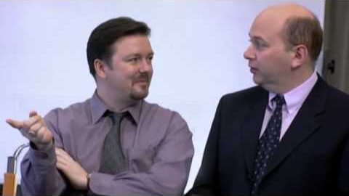

“A good idea…”

Slide 15
Questions?
@bitesizedteach
@samthom90
https://content.hee.nhs.uk/bitesized-teaching/resources.html

