Slide 1


Early Lessons from the
European Junior Leadership
Academy
Stacy Johnson
Associate Professor
University of Nottingham
School of Health Sciences
Twitter: @misssdjohnson
Website:www.ejla.eu

Slide 2
Today
About the European Junior Leadership Academy
Is Junior Leadership a thing?
Any application to GEN students and GEN programmes?
Twitter: @misssdjohnson
Notes:
Examples of good practice
Commissioning of the attainment gap report
Engineering has hired an EDI officer
The Stellar HE programme
BME Peer mentoring pilot in the SHS

Slide 3
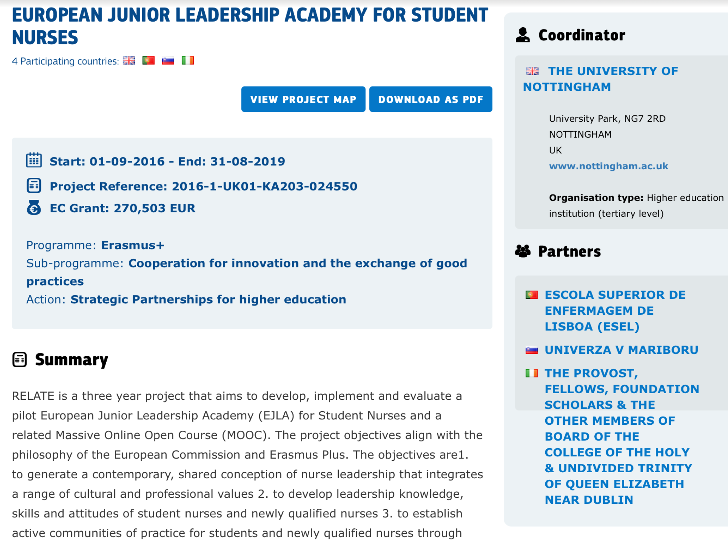
The European Junior Leadership Academy for Student Nurses: reLAte
Notes:
Examples of good practice
Commissioning of the attainment gap report
Engineering has hired an EDI officer
The Stellar HE programme
BME Peer mentoring pilot in the SHS

Slide 4
The reLAte Project
3 year project
4 partners
Sharing innovation in leadership development among educators
Leadership development for student nurses and midwives
Sharing among 40 students
Staff and student mobility
Notes:
Examples of good practice
Commissioning of the attainment gap report
Engineering has hired an EDI officer
The Stellar HE programme
BME Peer mentoring pilot in the SHS

Slide 5
Leadership
Festival
Required a Shared Conception of…
  Leadership for contemporary and future European nursing
  Student leadership
  Junior leadership
  Twitter: @misssdjohnson
Notes:
Examples of good practice
Commissioning of the attainment gap report
Engineering has hired an EDI officer
The Stellar HE programme
BME Peer mentoring pilot in the SHS

Slide 6
Leadership
“A process of social influence in which one person can enlist the aid and support of others in the accomplishment of a common task.”
(Chemers 1997)
                Twitter: @misssdjohnson
Notes:
Examples of good practice
Commissioning of the attainment gap report
Engineering has hired an EDI officer
The Stellar HE programme
BME Peer mentoring pilot in the SHS

Slide 7
Early Lessons from
Leadership Festival
Escola Superior de Enfermegem de Lisboa April 2017
Educators perceptions of leadership and junior leadership
Hothouse: ideas growing under ideal conditions
  Students, patients, service users, student leaders, educators, practitioners
Notes:
Examples of good practice
Commissioning of the attainment gap report
Engineering has hired an EDI officer
The Stellar HE programme
BME Peer mentoring pilot in the SHS

Slide 8
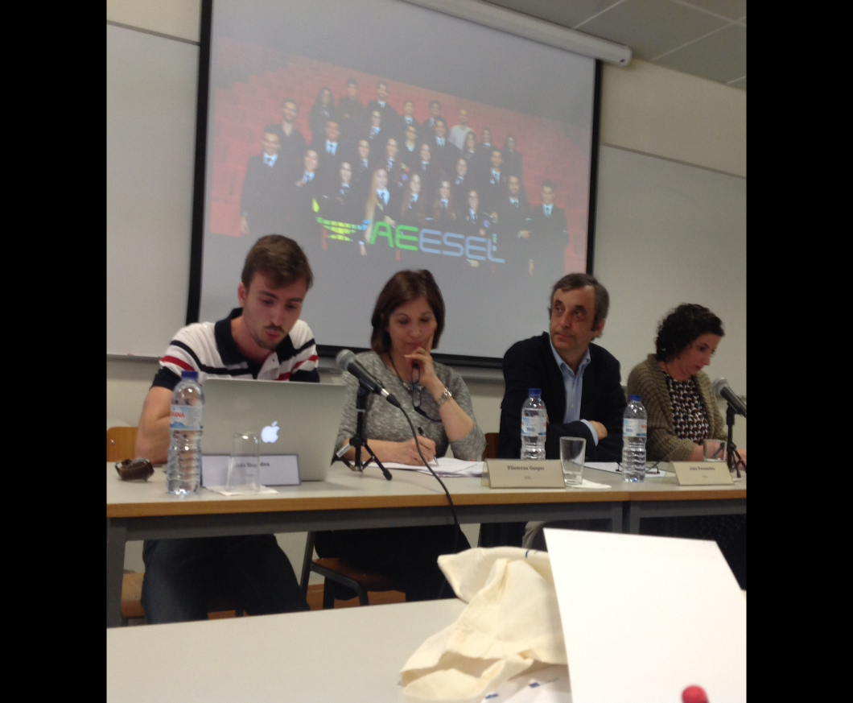
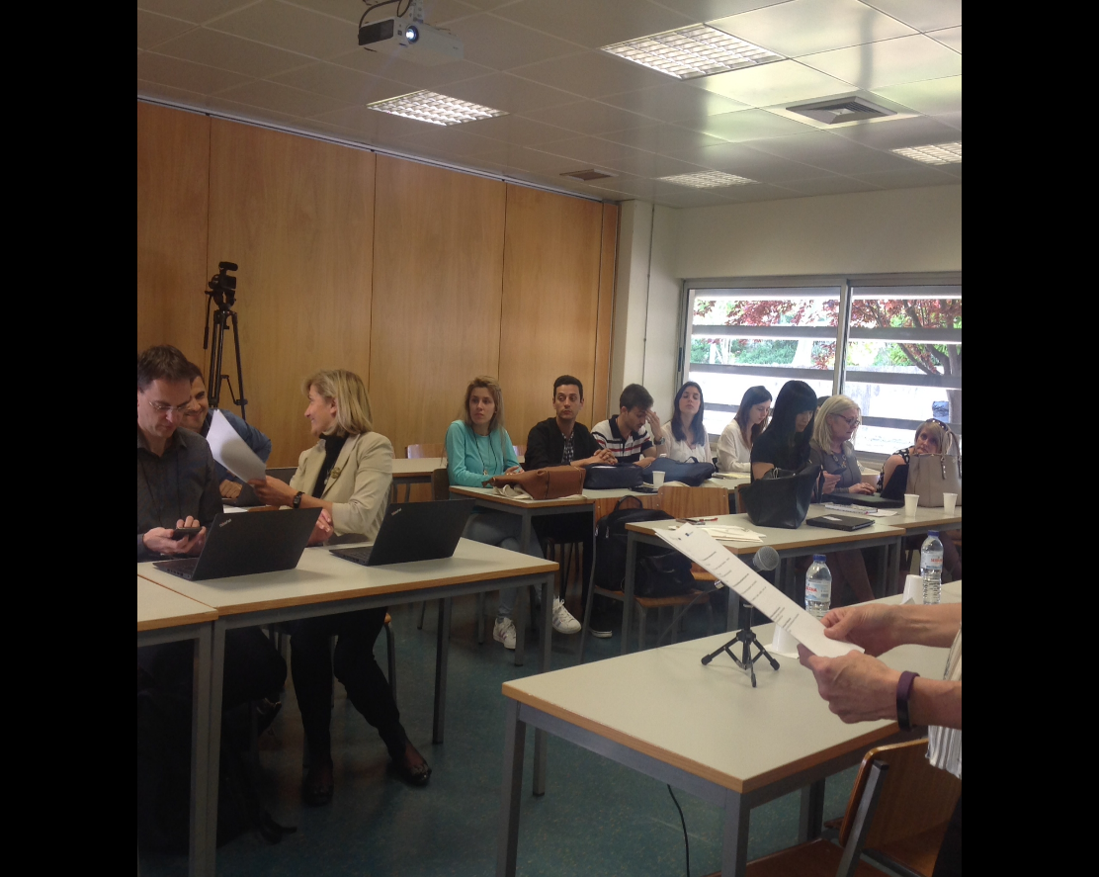
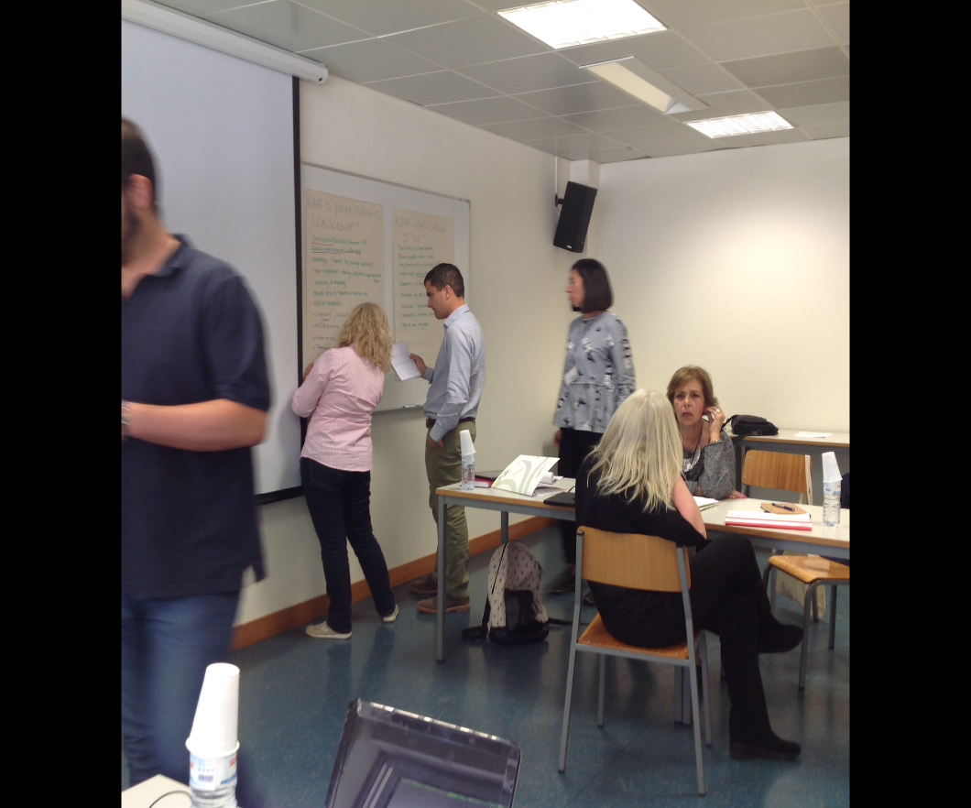
The reLAte Project
Leadership Festival ESEL: Lisboa March 2017
Notes:
Examples of good practice
Commissioning of the attainment gap report
Engineering has hired an EDI officer
The Stellar HE programme
BME Peer mentoring pilot in the SHS

Slide 9
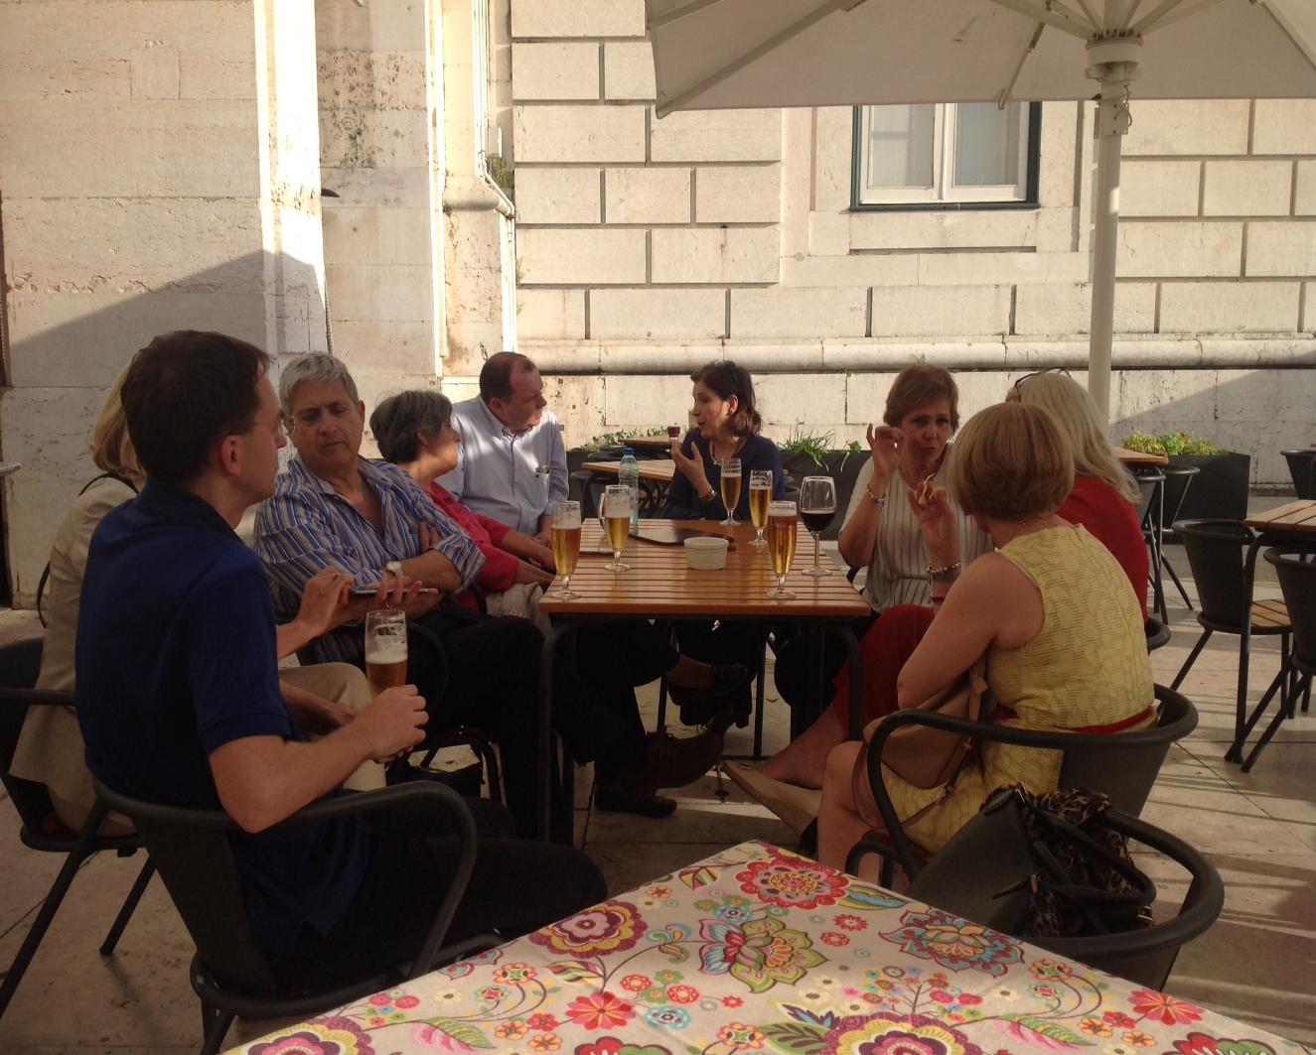
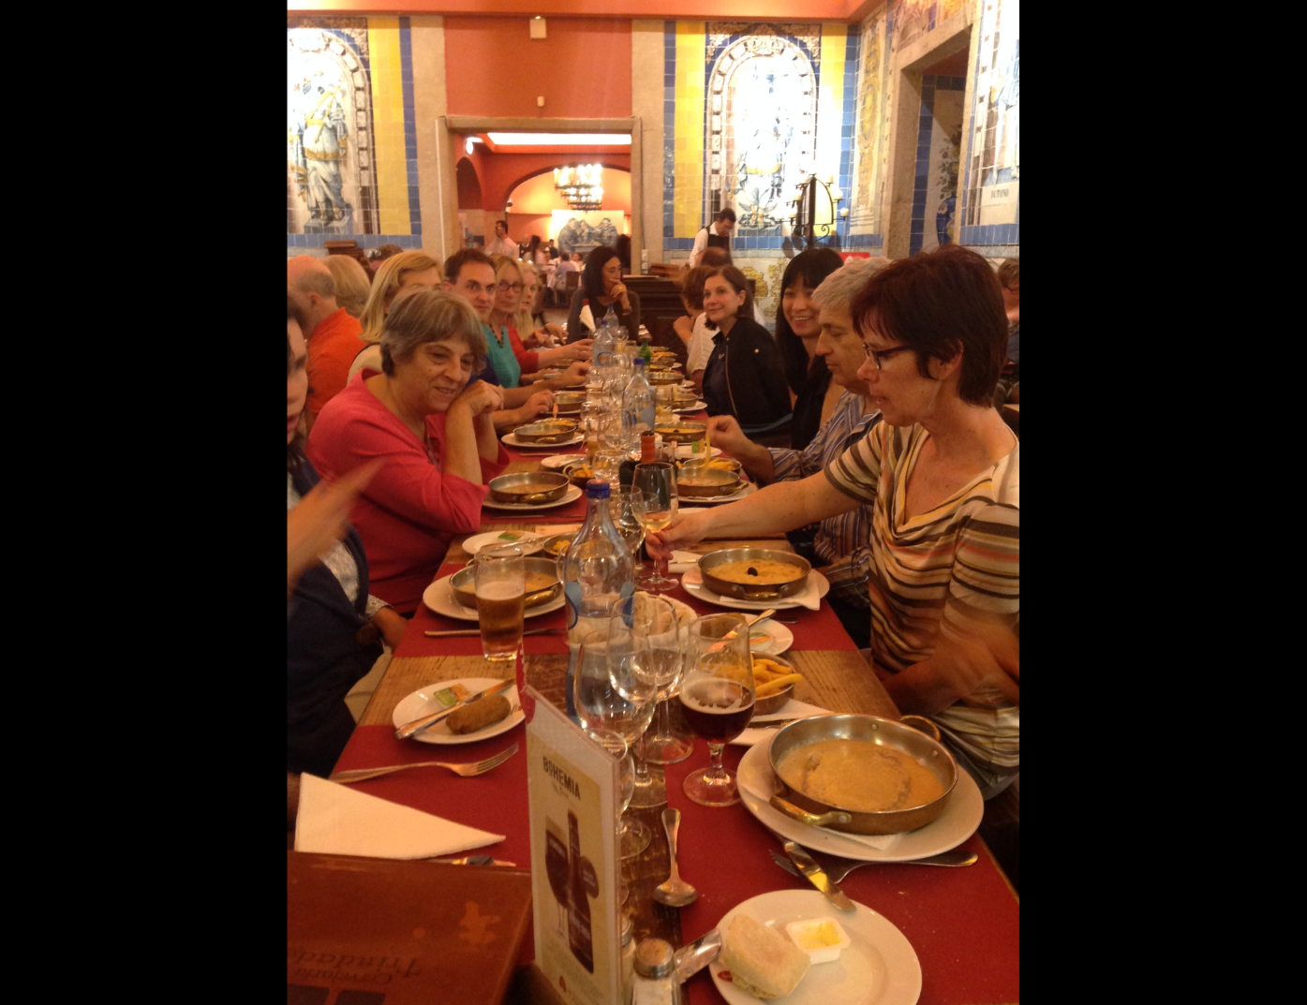
The reLAte
Team
Notes:
Examples of good practice
Commissioning of the attainment gap report
Engineering has hired an EDI officer
The Stellar HE programme
BME Peer mentoring pilot in the SHS

Slide 10
Junior Leadership
Future Leaders vs Now Leaders
Being leaderly: Don’t wait to lead
Organisations should not wait until they are more “senior” to capitalize and gain from the leadership aptitude of junior leaders
Should not wait to offer leadership development until junior leaders are in senior/leadership/management positions
Notes:
Examples of good practice
Commissioning of the attainment gap report
Engineering has hired an EDI officer
The Stellar HE programme
BME Peer mentoring pilot in the SHS

Slide 11
Junior Leadership
Leadership at the start of the career journey
Leadership from the margins: voices that are normally silent
Notes:
Examples of good practice
Commissioning of the attainment gap report
Engineering has hired an EDI officer
The Stellar HE programme
BME Peer mentoring pilot in the SHS

Slide 12
Junior Leadership
Characteristics not unique individually
But
in combination, produce a brand of leadership that is distinctive
Notes:
Examples of good practice
Commissioning of the attainment gap report
Engineering has hired an EDI officer
The Stellar HE programme
BME Peer mentoring pilot in the SHS

Slide 13
Festival Findings: Features of Junior Leadership
Influence in the absence of positional authority or organisational/professional seniority
Making the old new and the new novel
The approach of experiences with fascination
Notes:
Examples of good practice
Commissioning of the attainment gap report
Engineering has hired an EDI officer
The Stellar HE programme
BME Peer mentoring pilot in the SHS

Slide 14
Festival Findings: The Warrant for Junior Leadership
:
The conviction of idealism
The courage of the curious
The as yet unjaded spirit
Notes:
Examples of good practice
Commissioning of the attainment gap report
Engineering has hired an EDI officer
The Stellar HE programme
BME Peer mentoring pilot in the SHS

Slide 15
The Instruments of Junior Leadership
Simplification of complexity through naiveté
Historical skepticism
The restless mind
The audacity of the novice
Unbound, unsocialised nursing/midwifery minds
Notes:
Examples of good practice
Commissioning of the attainment gap report
Engineering has hired an EDI officer
The Stellar HE programme
BME Peer mentoring pilot in the SHS

Slide 16
Developing Junior Leaders in the EJLA
Identify students with leadership aptitude
Develop leadership identity
Expose students to leadership signatures
Get them to consider their leadership legacy
Notes:
Examples of good practice
Commissioning of the attainment gap report
Engineering has hired an EDI officer
The Stellar HE programme
BME Peer mentoring pilot in the SHS

Slide 17
What is identity?
“Who am I?”
“How should I act?”
Identity
is a social construct, which describes the subjective nature of meanings and experience within societal structures (Mead, 1934; Alvesson et al, 2008, Hogg et al, 1995).
Notes:
As such, identity motivates behavioural attempts to confirm or verify its existence (Burke and Stets, 1999; McCall and Simmons, 1966).
The second question goes to the behaviours an individual engages in to confirm this self-concept and asks

Slide 18
Developing Leadership Identity in Junior Leaders
Internal view of self as leader
Identity work
Identity formation
Notes:
Examples of good practice
Commissioning of the attainment gap report
Engineering has hired an EDI officer
The Stellar HE programme
BME Peer mentoring pilot in the SHS

Slide 19
Professional Hybrids
Amidst conditions of modernity and the impact of varying demands on the self, individuals still require a consistent conception of who they are to be effective social actors
(Watson, 2008; Krueger, 2007; Alvesson & Willmot, 2002).
Notes:
Examples of good practice
Commissioning of the attainment gap report
Engineering has hired an EDI officer
The Stellar HE programme
BME Peer mentoring pilot in the SHS

Slide 20
Are GEN students a type of Professional Hybrid?
The ability of hybrids to alternate between these two distinct functions and align professional and organisational demands is indicative of how valuable hybrids can be to these organisations
(Ferlie, Fitzgerald, Wood & Hawkins 2005; Noordegraaf & Van Der Meulen 2008; Llewellyn, 2001)
Notes:
Examples of good practice
Commissioning of the attainment gap report
Engineering has hired an EDI officer
The Stellar HE programme
BME Peer mentoring pilot in the SHS

Slide 21
Let’s Play
www.kahoot.it
Pin: 1576332
Notes:
Examples of good practice
Commissioning of the attainment gap report
Engineering has hired an EDI officer
The Stellar HE programme
BME Peer mentoring pilot in the SHS

Slide 22
Current Leadership Development of GEN students.
What leadership development is in your curriculum now?
Go to Padlet
Take 5 minutes to post what is happening in your institution’s GEN programme
Notes:
Examples of good practice
Commissioning of the attainment gap report
Engineering has hired an EDI officer
The Stellar HE programme
BME Peer mentoring pilot in the SHS

Slide 23
The EJLA
Programme
12 month leadership development experience for student nurses and midwives
Leadership Retreat I
Senior national nurse mentor
2 week policy/leadership internship outside own country e.g. Department of Health, NHS England, Ministry
Regional peer project supported by peer facilitators (newly qualified nurses)
Leadership Retreat II: Maribor Summer 2018
Notes:
Examples of good practice
Commissioning of the attainment gap report
Engineering has hired an EDI officer
The Stellar HE programme
BME Peer mentoring pilot in the SHS

Slide 24
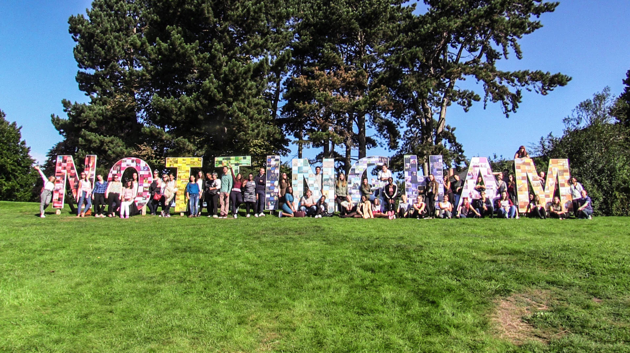
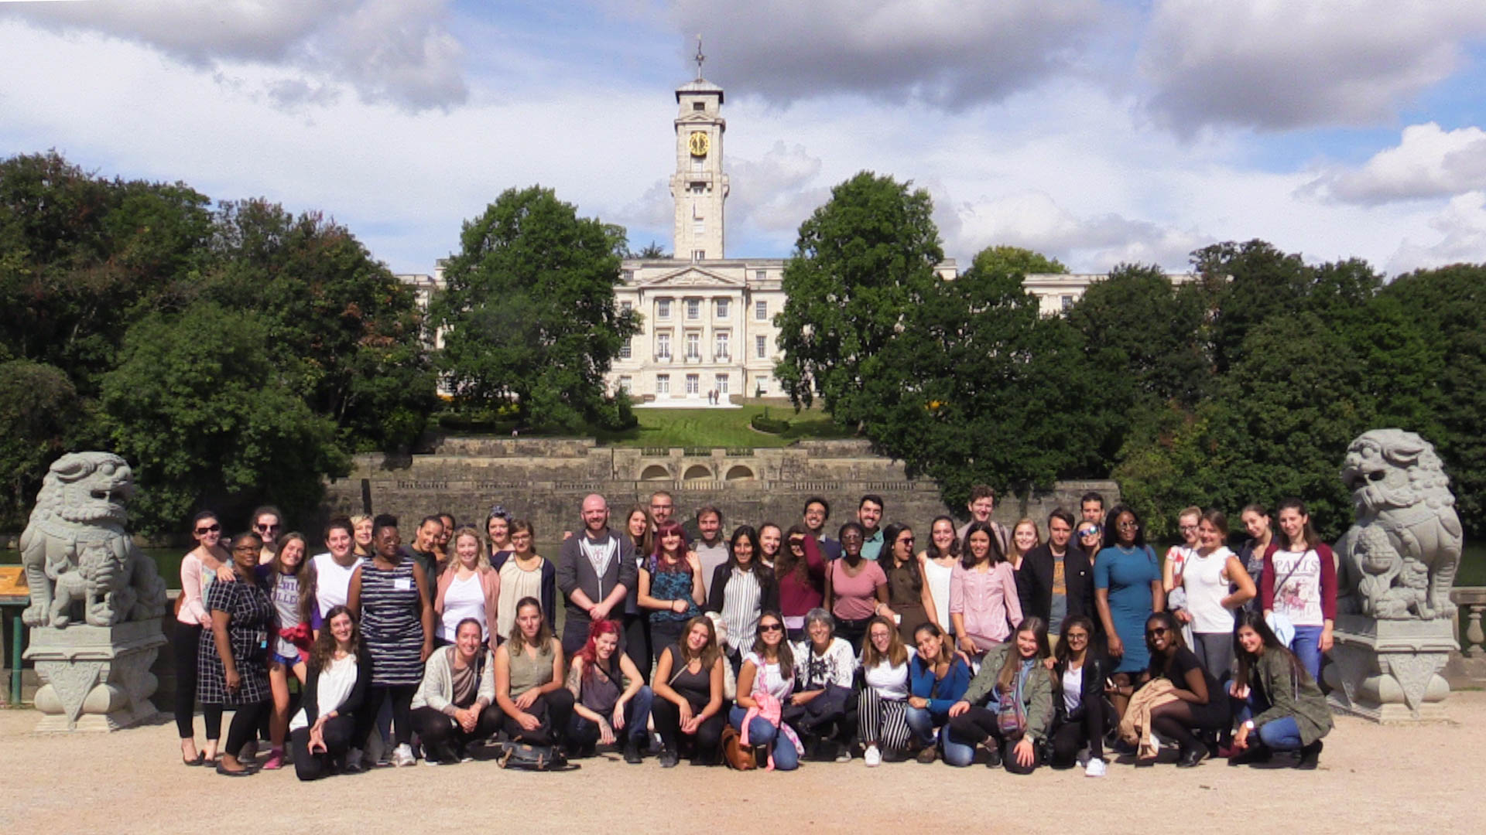
The reLAte Project
Student Leadership Retreat I
Nottingham August 2017
Notes:
Examples of good practice
Commissioning of the attainment gap report
Engineering has hired an EDI officer
The Stellar HE programme
BME Peer mentoring pilot in the SHS

Slide 25
Any Lessons for Leadership Development of GEN students?
What does this mean for GEN curricula?
How do we develop leadership identity in GEN students?
What leadership development activities do your students get involved in?
What does this mean for leadership experiences in practice?
Exercise 2
Go to Padlet. Take 5 minutes to post ideas about new leadership development initiatives.
Notes:
Examples of good practice
Commissioning of the attainment gap report
Engineering has hired an EDI officer
The Stellar HE programme
BME Peer mentoring pilot in the SHS

Slide 26
Democratising
Leadership
Lead Now! MOOC
Scaling up
Live Academy 45
Massive Online Open Course (MOOC) Spring/summer 2018 + spring 2019
  Any student nurse/midwife with internet access
  Thousands????
Your students can join this online course: Look out for information on the website
www.ejla.eu
Notes:
Examples of good practice
Commissioning of the attainment gap report
Engineering has hired an EDI officer
The Stellar HE programme
BME Peer mentoring pilot in the SHS

Slide 27
Discussion
Contact
stacy.johnson@nottingham.ac.uk
@misssdjohnson
Skype: stacy.johnson090971
www.ejla.eu

