Slide 1


Graduate Entry Nurses- Transition To Practice
Marie McGee

Slide 2

GEN Education
Accelerated Programme
Curriculum Developed :
To provide graduates with an understanding of the breadth of nursing and contemporary healthcare
Knowledge and skills required of entry level nurses
Higher level critical thinking and analysis to prepare graduates to manage complexity in today’s health care
Graduates enter Nursing:
To Care
To make a difference
Employability

Slide 3

From student to qualified nurse
Transition to Practice –Develops over time
Transitioning from student nurse to qualified nurse can be a stressful and challenging time
Start off as a novice
Initially express same concerns as a traditional nurse, fear of inadequacy and incompetence, lacking in confidence (6-12 months)
Develop at a quicker pace than traditional nurse
Building resilience
(Shatto et al 2016)
Notes:
Perseverance
Belief in ones self
Recognition of personal strengths

Slide 4

Factors that support GEN transition to Practice
Education _ preparedness for their nursing career
A positive work environment – supportive –free from negativity around Master’s level nurses
Acknowledgement of their commitment to nursing (Stacey et al 2012)
Supportive preceptors/ Preceptorship
Clear role expectations
Career Advancement
Lifelong Learning
(Shatto et al 2018)

Slide 5
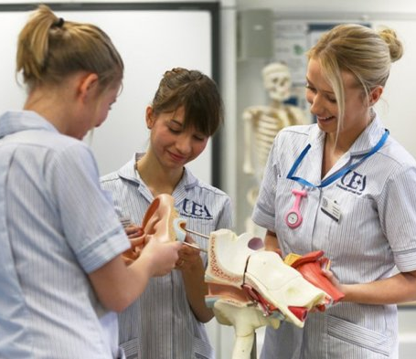
Current Challenges
Increasingly challenging healthcare working environment
Managing day-to-day care provision with diminished staffing levels
Increasingly more complex patient requirements.

Slide 6

Future Considerations
Transition – critical period-finding their feet
Nurturing environment to support transitioning of roles from student to qualified nurse
Professional satisfaction fluctuates in the first year of practice
Adequately Prepared for the reality of Nursing
Need graduates that are still glad they chose nursing
Length of time staying in first qualified post
Retention of qualified nurses
Pressure of being seen as leaders

Slide 7

Future Considerations
Facilitate career development
Foster a vibrant nursing workforce

Slide 8
References
Meyer G, Shatto B. Resilience and transition to practice in Direct Entry nursing graduates. Nurse Education in Practice. 2018;28:276-279. doi:10.1016/j.nepr.2017.10.008
Shatto B, Meyer G, Delicath TA. The transition to practice of Direct Entry Clinical Nurse Leader graduates. Nurse Education in Practice. 2016;19:97-103. doi:10.1016/j.nepr.2016.05.008.
Stacey G, McGarry J, Aubeeluck A, et al. An integrated educational model for graduate entry nursing cirriculum design. Nurse Education Today. 2014;34(1):145-149. doi:10.1016/j.nedt.2012.08.014.

