Slide 1


Graduate Entry Nursing International Network:
Dr Gemma Stacey – University of Nottingham

Slide 2
Mission
An international community of practice comprising of academics, students and graduates working together to explore and enhance the potential of Graduate Entry Nursing (GEN) to positively influence the nursing workforce.
This is achieved through the development of a collective knowledge which contributes to pedagogical nursing scholarship and curriculum innovation.

Slide 3
Objectives
Promote opportunities for GEN educators, students and alumni to network for the purpose of collaboration and professional development.
Provide a community of support for curriculum development, validation and assist in quality assurance.
Deliver multi-centre research and evaluation which demonstrates the attributes and features of GEN students and alumni.
Benchmark standards for GEN curriculum which maximise graduate attributes for nursing practice.
Influence at a strategic level to support workforce planning and professional regulation to enhance the sustainability and recognition of GEN.
Utilise online platforms to disseminate outcomes, good practice and resources which contribute to enhancing the wider profile of GEN

Slide 4
Online Profile
Twitter
@GEN_Int_Network
210 followers
Facebook group – Loren Bigwood (UEA) L.Bigwood@uea.ac.uk
Website
www.genintnetwork.org

Slide 5
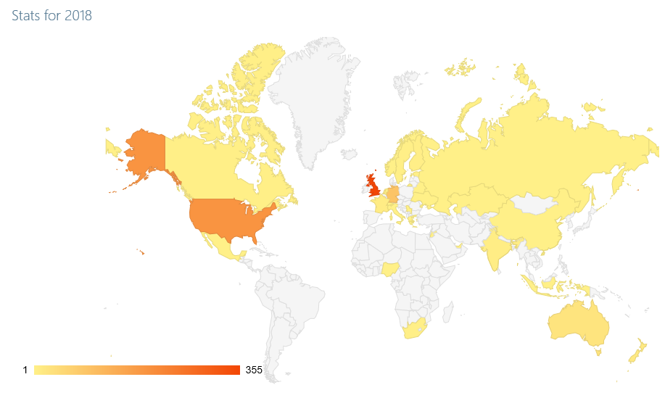
Traffic to Website
Website
www.genintnetwork.org
1st quarter – 355 visits, 31 countries

Slide 6
Highlights
Special Issue – Nurse Education in Practice
Network highly represented as authors and reviewers
International GEN Int Network Meeting/Special Issue Launch – NETNEP 2018 Banff, Canada
2nd Student and Alumni Conference 2018 – Oxford Brookes University
Opportunity to work with Council of Deans/ Department of Health on sustainable funding model

Slide 7
Internationalisation
Current
Resilience, GRIT and transition to practice
US, Australia, UK
Curriculum Benchmarking
Australia, New Zealand, UK
The impact and influence of GEN graduates on the Workforce
Australia, UK, US
Universitas 21

Slide 8
Students and Alumni
Convened a steering group who identified the priorities and opportunities for networking.
Dedicated area on the website for students and alumni
Populated through the resources and conversations from today
Discussion forum
Annual student/ alumni conference
National student/ alumni facebook group

Slide 9
Today!!!!
Presentations, workshops and panel discussions
Discussions with the GEN student/alumni community

